Slide 1
Project ACCESS Bioinformatics Workshop Summer 2024 – July 29, 30; 2024 Micah Andrew Thornton ©

Slide 2

Who am I?
B.Sc. - Statistical Science & Computer Engineering (SMU, 2017)
M.S – Computer Engineering (SMU, 2017)
Ph. D. - Biostatistics (SMU/UTSW, 2021)
Post-Doctoral Research Certification (UTSW 2024) –
Daehwan Kim Lab (UTSW, 2021-2023)
Sequence Alignment and Statistical Models
Lee Kraus Lab (UTSW, 2023)
Statistical Models for RPol-II Propagation

Slide 3
What is this Workshop?
Hosted by Texas Woman’s University’s Project ACCESS
Held over two days (July 29, 30; 2024)
Using the tools of Bioinformatics:
Gives introduction and theory background.
Provides hands-on tool use experience.

Slide 4
Day 1 (July 29, 2024)
Focus on the basics:
Introduction:
What is/is not Bioinformatics?
Assembly/Human Reference Genome
Tools of Bioinformatics:
Standard File Formats
Genome Browsers
Multiple Sequence Alignment - BLAST

Slide 5
Day 2 (July 30, 2024)
Command-line Tools:
Review of Day 1
Linux – History and Basic Utilities
Sequence Aligners – HISAT2
SAMTOOLS and BCFTOOLS
R Tools:
DESeq2

Slide 6
Day 1

Slide 7
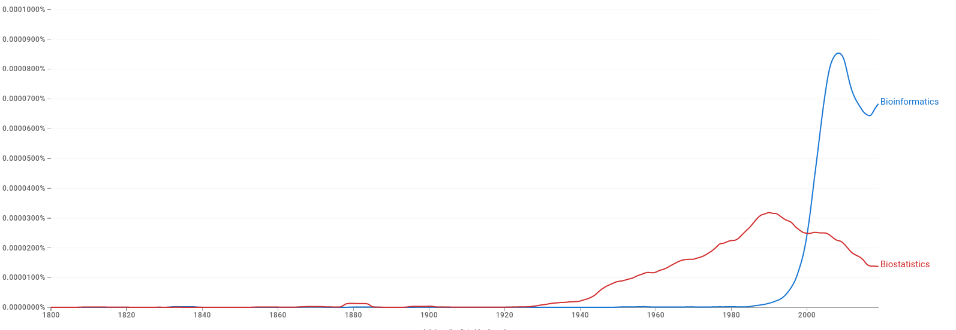

Introduction to Bioinformatics
First recorded use of the term Bioinformatics was in 1970.
Development of systematic and algorithmic methods (mathematical, statistical, computational) for drawing biological and medical insights from large and complex data sources.
Lin, Y., Michel, J.-B., Aiden, E. L., Orwant, J., Brockman, W., and Petrov, S. (2012). Syntactic annotations for the Google Books Ngram Corpus. Proceedings of the ACL 2012 system demonstrations, 169-174.

Slide 8
History of Bioinformatics
1950
1950
(late 1950s) – Edman (Pehr Edman) Protein Sequencing – ~60 AA segments
1960
1970
1980
1990
2000

Slide 9
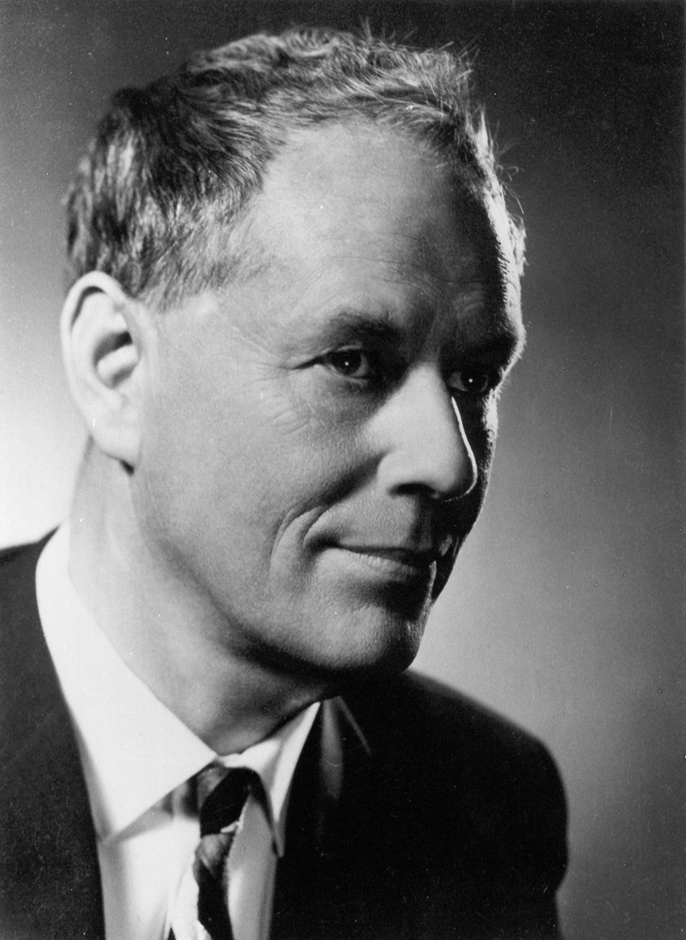
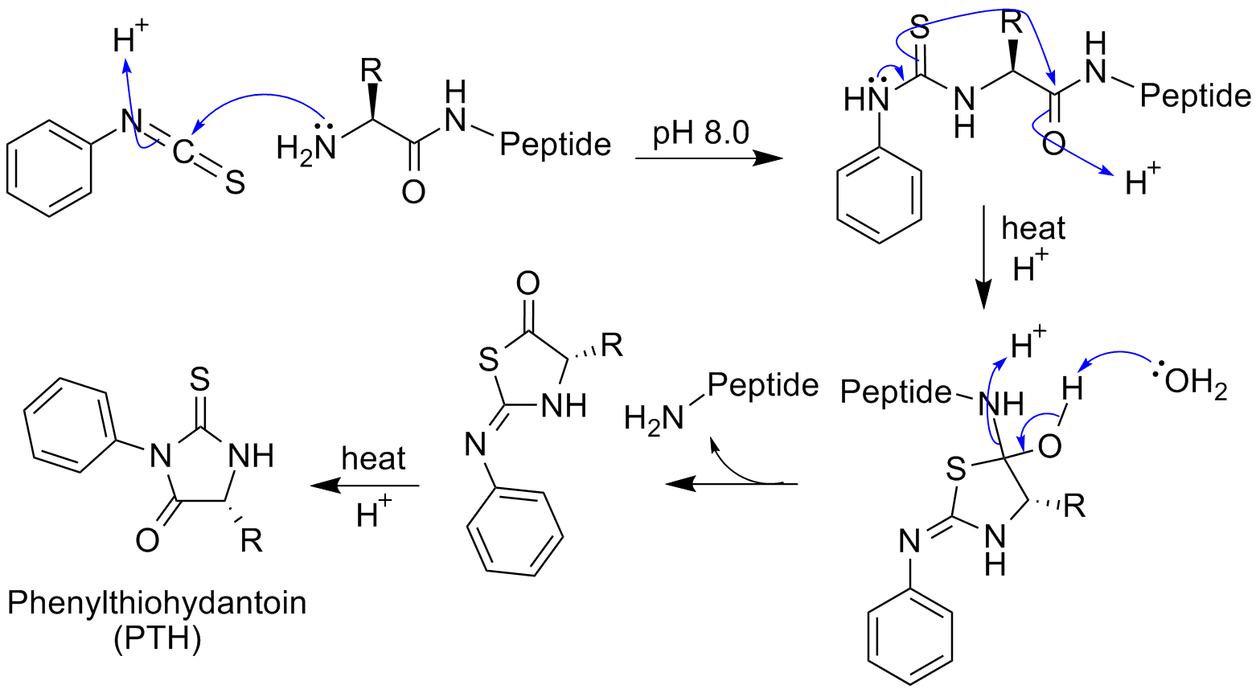
History of Bioinformatics
Phenyl Isothiocyanate
N-Terminus Peptide
+

Slide 10
History of Bioinformatics
1950
1950
(late 1950s) – Edman (Pehr Edman) Protein Sequencing – ~60 AA segments
1960
(1962) - COMPROTEIN Developed (Margaret Oakley Dayhoff) – Allowed Assembling of peptide sequences into larger proteins
1970
1980
1990
2000

Slide 11
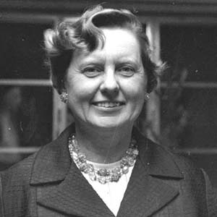
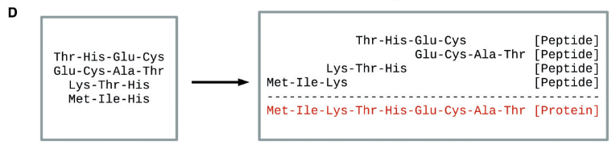
History of Bioinformatics
Jeff Gauthier, Antony T Vincent, Steve J Charette, Nicolas Derome, A brief history of bioinformatics, Briefings in Bioinformatics, Volume 20, Issue 6, November 2019, Pages 1981–1996, https://doi.org/10.1093/bib/bby063

Slide 12
History of Bioinformatics
1950
1950
(late 1950s) - Edman (Pehr Edman) Protein Sequencing – ~60 AA segments
1960
(1962) - COMPROTEIN Developed (Margaret Oakley Dayhoff) – Allowed Assembling of peptide sequences into larger proteins
1970
(1970) – Needleman and Wunsch – Develop Dynamic Programming Approach for computing Sequence Dissimilarity + End to End Alignment.
1980
1990
2000

Slide 13
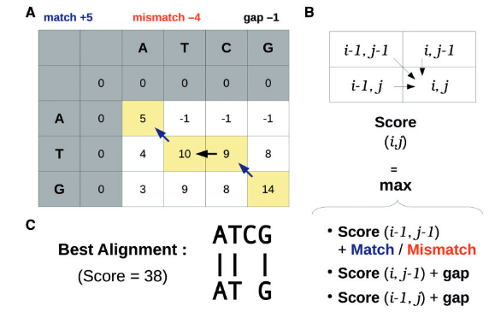
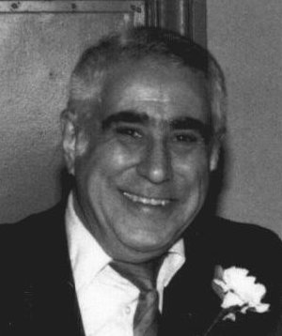
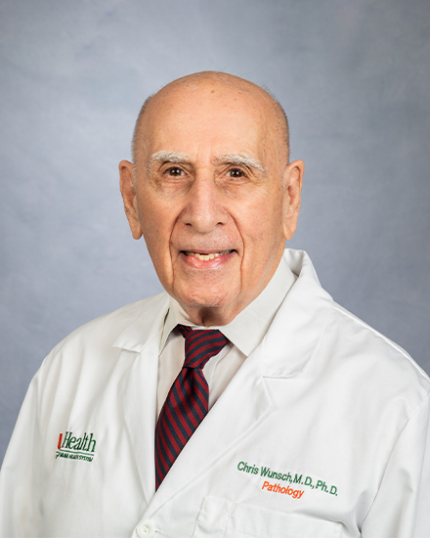
History of Bioinformatics
Jeff Gauthier, Antony T Vincent, Steve J Charette, Nicolas Derome, A brief history of bioinformatics, Briefings in Bioinformatics, Volume 20, Issue 6, November 2019, Pages 1981–1996, https://doi.org/10.1093/bib/bby063

Slide 14
History of Bioinformatics
1950
1950
(late 1950s) - Edman Protein Sequencing – ~60 AA segments
1960
(1962) - COMPROTEIN Developed – Allowed Assembling of peptide sequences into larger proteins
1970
(1970) – Needleman and Wunsch – Develop Dynamic Programming Approach for computing Sequence Dissimilarity.
*
1980
(1981) – Smith and Waterman – Build upon Needleman and Wunsch for Local Alignment
1990
2000
* 1975 – Sanger Sequencing for DNA invented

Slide 15
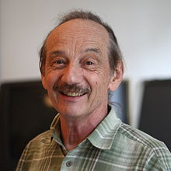
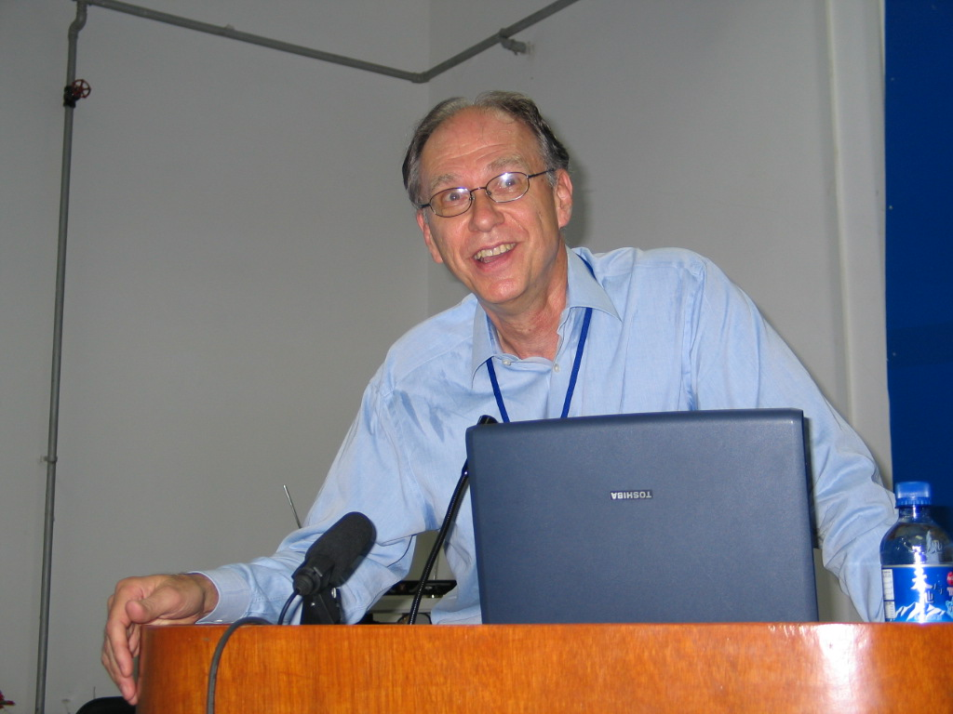
History of Bioinformatics
Updated Needleman-Wunsch (NW) in 2 ways:
Add a fixed minimum (say 1)
Terminate Local alignments when fixed minimum met/Start anywhere in matrix

Slide 16
History of Bioinformatics
 |  | Y | R | M | N | P | Y | C | N | M
 | 0 | 0 | 0 | 0 | 0 | 0 | 0 | 0 | 0 | 0
Y | 0 | 5 | 4 | 3 | 2 | 1 | 5 | 4 | 3 | 2
C | 0 | 4 | 3 | 2 | 1 | 1 | 4 | 10 | 9 | 8
N | 0 | 3 | 2 | 1 | 7 | 6 | 3 | 9 | 15 | 14
P | 0 | 2 | 1 | 1 | 6 | 12 | 2 | 8 | 14 | 11
Local alignment for ‘YCNP’ in the longer but similar string as before ‘YRMNPYCNM’
Alignment 1:
(15 + 10 + 5 = 30)
Alignment 2:
(19+6+5 = 30)
‘YRMNPYCNM’
‘YRMNPYCNM’
‘YCN’
‘Y−CNP’

Slide 17
History of Bioinformatics
1950
1950
(late 1950s) - Edman Protein Sequencing – ~60 AA segments
1960
(1962) - COMPROTEIN Developed – Allowed Assembling of peptide sequences into larger proteins
1970
(1970) – Needleman and Wunsch – Develop Dynamic Programming Approach for computing Sequence Dissimilarity.
1980
(1981) – Smith and Waterman – Build on Needleman and Wunsch (Local Alignment)
(1985) – FASTA Algorithm and files created by Lipman and Pearson.
(1989) – BLAST Algorithm created (Myers, Altschul, Gish, Lipman, and Miller).
1990
2000

Slide 18
History of Bioinformatics
1950
1950
(late 1950s) - Edman Protein Sequencing – ~60 AA segments
1960
(1962) - COMPROTEIN Developed – Allowed Assembling of peptide sequences into larger proteins
1970
(1970) – Needleman and Wunsch – Develop Dynamic Programming Approach for computing Sequence Dissimilarity.
1980
(1981) – Smith and Waterman – Build on Needleman and Wunsch (Local Alignment)
(1985) – FASTA Algorithm and files created by Lipman and Pearson.
(1989) – BLAST Algorithm created (Myers, Altschul, Gish, Lipman, and Miller).
1990
(1994) – ClustalW released for practical Multiple Sequence Alignment
2000

Slide 19
History of Bioinformatics
2000
(2003) – Human Reference Genome Version 1 Completed.
(2005) – Next Generation Sequencing Introduced.
2010
2020

Slide 20
History of Bioinformatics
2000
(2003) – Human Reference Genome Version 1 Completed.
(2005) – Next Generation Sequencing Introduced.
(2009) – Bowtie (Ben Langmead, Steven Salzberg) Introduced.
2010
2020

Slide 21
History of Bioinformatics
2000
(2003) – Human Reference Genome Version 1 Completed.
(2005) – Next Generation Sequencing Introduced.
(2009) – Bowtie (Ben Langmead, Steven Salzberg) Introduced.
2010
(2015) – HISAT (Daehwan Kim, Ben Langmead, Steven Salzberg) Introduced.
2020

Slide 22
History of Bioinformatics
2000
(2003) – Human Reference Genome Version 1 Completed.
(2005) – Next Generation Sequencing Introduced.
(2009) – Bowtie (Ben Langmead, Steven Salzberg) Introduced.
2010
(2015) – HISAT (Daehwan Kim, Ben Langmead, Steven Salzberg) Introduced.
2020
(2019) – HISAT2 (Daehwan Kim, Ben Langmead, Steven Salzberg) Introduced.

Slide 23
History of Bioinformatics
2000
(2003) – Human Reference Genome Version 1 Completed.
(2005) – Next Generation Sequencing Introduced.
(2009) – Bowtie (Ben Langmead, Steven Salzberg) Introduced.
2010
(2015) – HISAT (Daehwan Kim, Ben Langmead, Steven Salzberg) Introduced.
2020
(2019) – HISAT2 (Daehwan Kim, Ben Langmead, Steven Salzberg) Introduced.
(2021) – HISAT3N (Y. Zhang, C. Park, C. Bennett, M. Thornton, and D. Kim).

Slide 24
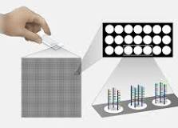
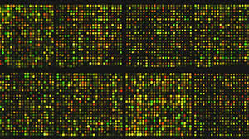
Sequencing Technologies – MicroArrays
Older Technology, used 1995 - ~2010.
Detects genetic expression through oligonucleotide probes
Fluorescence intensity used as proxy for sequence density.
https://www.youtube.com/watch?v=NgRfc6atXQ8
https://en.wikipedia.org/wiki/DNA_microarray
Credit NIH NHGRI & National Cancer Institute

Slide 25
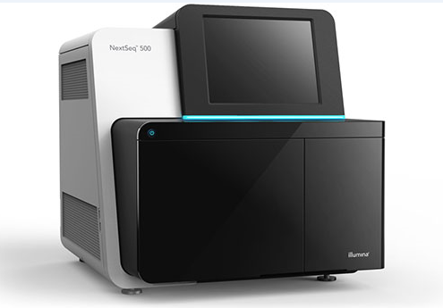
Sequencing Technologies – NGS Short Reads
Newer technology, used 2000 - ~2024
Detects sequence directly through fluorescently labeled nucleotides.
Produces many short “reads” – subsequences of original strand
https://www.youtube.com/watch?v=CZeN-IgjYCo
Credit Illumina

Slide 26
Paired end vs Single Reads
Reads can be sequenced as a single read
Or paired end reads with “inserts”
Generated by repeating last few steps of NGS

Slide 27
Assembly
Two types:
Reference-guided
De Novo (seen for first time)
Before reference was created we had to use De novo assembly methods!
Recall Dayhoff’s Comprotein!

Slide 28
De Novo Assembly – Naïve Approach
5’-AAACCAACCAACTTTCGATCTC-3’
5’-ATCTCATTATTAGTGATATGTA-3’
5’-GTGATATGTACGACCCTAAGAC-3’
5’-AAGACAGAATGATTGAACTTTC-3’
5’-CTTTCTTATGAACAATTTAAGA-3’
Adapted from Robert Edwards’ San Diego State University Course

Slide 29
De Novo Assembly – Naïve Approach
5’-AAACCAACCAACTTTCGATCTC-3’
5’-ATCTCATTATTAGTGATATGTA-3’
5’-GTGATATGTACGACCCTAAGAC-3’
5’-AAGACAGAATGATTGAACTTTC-3’
5’-CTTTCTTATGAACAATTTAAGA-3’
5’-AAACCAACCAACTTTCGATCTCATTATTAGTGATATGTACGACCCTAAGACAGAATGATTGAACTTTCTTATGAACAATTTAAGA-3’
Adapted from Robert Edwards’ San Diego State University Course

Slide 30
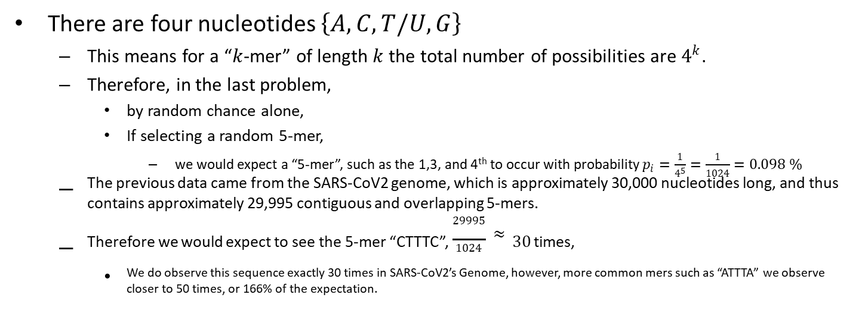
De Novo Assembly – Assumptions
There are four nucleotides $\left\{A,C,T/U,G\right\}$
This means for a “$k$-mer” of length $k$ the total number of possibilities are $4^{k}$.
Therefore, in the last problem,
by random chance alone,
If selecting a random 5-mer,
we would expect a “5-mer”, such as the 1,3, and 4th to occur with probability $p_{i}=\frac{1}{4^{5}}=\frac{1}{1024}=0.098 \%$
The previous data came from the SARS-CoV2 genome, which is approximately 30,000 nucleotides long, and thus contains approximately 29,995 contiguous and overlapping 5-mers.
Therefore we would expect to see the 5-mer “CTTTC”, $\frac{29995}{1024}≈30$ ^{times,}
We do observe this sequence exactly 30 times in SARS-CoV2’s Genome, however, more common mers such as “ATTTA” we observe closer to 50 times, or 166% of the expectation.

Slide 31
De Novo Assembly – Naïve Approach
Pros:
Simple to understand,
Easy to implement
Cons:
Short segments often repeated in sequences
Organisms are diploid (or polyploid)
Mismatches cause misassembles

Slide 32
De Novo Assembly – Greedy Approach
Start with one sequence,
Match to all other sequences,
If there is a match extend the overall sequence until you cannot extend any further, this forms a “contig”
Exclude all sequences within that contig,
Repeat until all contigs found

Slide 33
De Novo Assembly – OLC Approach
Overlap Layout Consensus –
Perform Multiple Sequence Alignment on Reads and then take the consensus (most commonly occurring base).

Slide 34
De Novo Assembly – De Brujin Approach
De Brujin Graphs can be used to represent a sequence or a subsequence of a sequence in a mathematical graph structure.

Slide 35
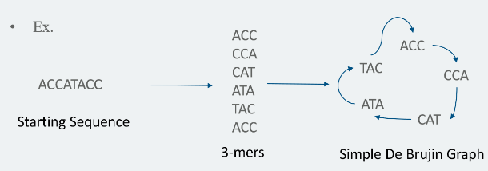
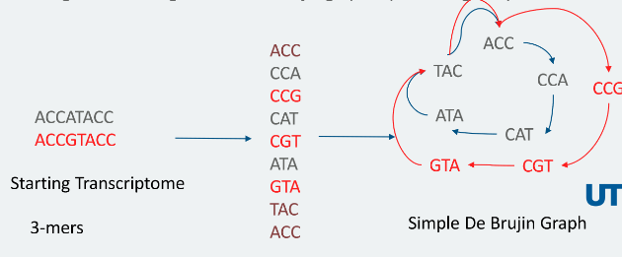

De Brujin Graphs
De Brujin graphs are a simple mathematical structure that can be used to represent a sequence by sub-sequences
The “colored” version of the debrujin graph represents sets of sequences by different “colors”
We will see these again tomorrow for pseudo-alignment!

Slide 36
De Brujin Graph Assembly
5’ – AACCGGTTA – 3’
5’ –GGTTATAC – 3’

Slide 37
De Brujin Graph Assembly
5’ – AACCGGTTA – 3’
5’ –GGTTATAC – 3’
AACC
GGTT
ACCG
GTTA
CCGG
TTAT
CGGT
TATA
GGTT
ATAC
GTTA

Slide 38
De Brujin Graph Assembly
5’ – AACCGGTTA – 3’
5’ –GGTTATAC – 3’
AACC
GGTT
ACCG
GTTA
CCGG
TTAT
CGGT
TATA
GGTT
ATAC
GTTA
5’- A -3’

Slide 39
De Brujin Graph Assembly
5’ – AACCGGTTA – 3’
5’ –GGTTATAC – 3’
AACC
GGTT
ACCG
GTTA
CCGG
TTAT
CGGT
TATA
GGTT
ATAC
GTTA
5’- AA -3’

Slide 40
De Brujin Graph Assembly
5’ – AACCGGTTA – 3’
5’ –GGTTATAC – 3’
AACC
GGTT
ACCG
GTTA
CCGG
TTAT
CGGT
TATA
GGTT
ATAC
GTTA
5’- AAC -3’

Slide 41
De Brujin Graph Assembly
5’ – AACCGGTTA – 3’
5’ –GGTTATAC – 3’
AACC
GGTT
ACCG
GTTA
CCGG
TTAT
CGGT
TATA
GGTT
ATAC
GTTA
5’- AACC -3’

Slide 42
De Brujin Graph Assembly
5’ – AACCGGTTA – 3’
5’ –GGTTATAC – 3’
AACC
GGTT
ACCG
GTTA
CCGG
TTAT
CGGT
TATA
GGTT
ATAC
GTTA
5’- AACCG -3’

Slide 43
De Brujin Graph Assembly
5’ – AACCGGTTA – 3’
5’ –GGTTATAC – 3’
AACC
GGTT
ACCG
GTTA
CCGG
TTAT
CGGT
TATA
GGTT
ATAC
GTTA
5’- AACCGG -3’

Slide 44
De Brujin Graph Assembly
5’ – AACCGGTTA – 3’
5’ –GGTTATAC – 3’
AACC
GGTT
ACCG
GTTA
CCGG
TTAT
CGGT
TATA
GGTT
ATAC
GTTA
5’- AACCGGT -3’

Slide 45
De Brujin Graph Assembly
5’ – AACCGGTTA – 3’
5’ –GGTTATAC – 3’
AACC
GGTT
ACCG
GTTA
CCGG
TTAT
CGGT
TATA
GGTT
ATAC
GTTA
5’- AACCGGTT -3’

Slide 46
De Brujin Graph Assembly
5’ – AACCGGTTA – 3’
5’ –GGTTATAC – 3’
AACC
GGTT
ACCG
GTTA
CCGG
TTAT
CGGT
TATA
GGTT
ATAC
GTTA
5’- AACCGGTTATAC -3’

Slide 47
Building Reference Genome
Reference Genomes
summarize information from multiple organisms,
are usually haploid (exception discussed later),
present an idealized sequence (by consensus),
and built using De Novo Sequence Assembly approaches
SPAdes
Abyss

Slide 48
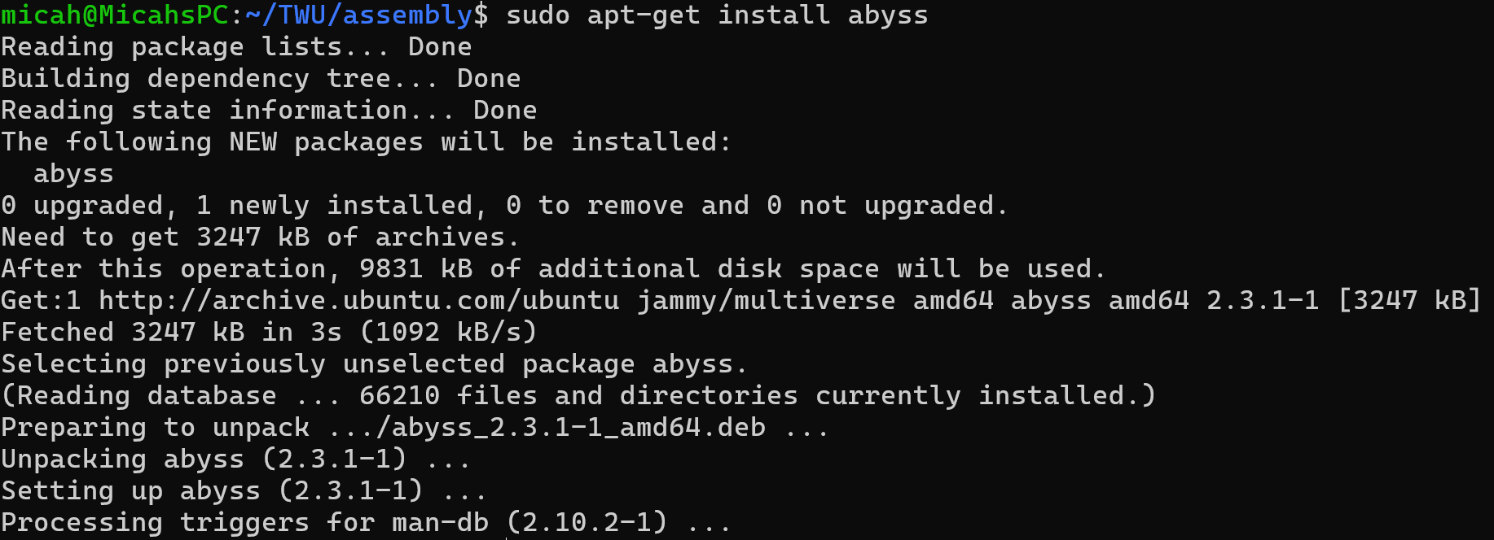
Abyss tutorial
Install abyss software:
sudo apt-get install abyss

Slide 49
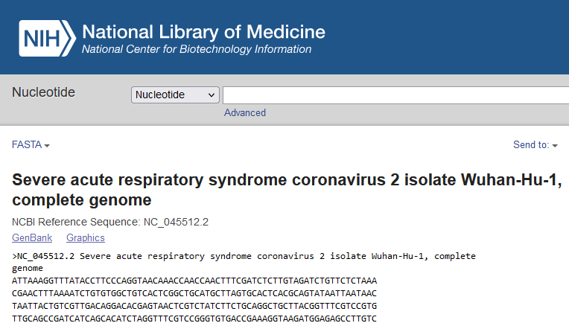
Abyss tutorial
Download Sars-Cov-2 genome:
https://www.ncbi.nlm.nih.gov/nuccore/NC_045512.2?report=fasta

Slide 50
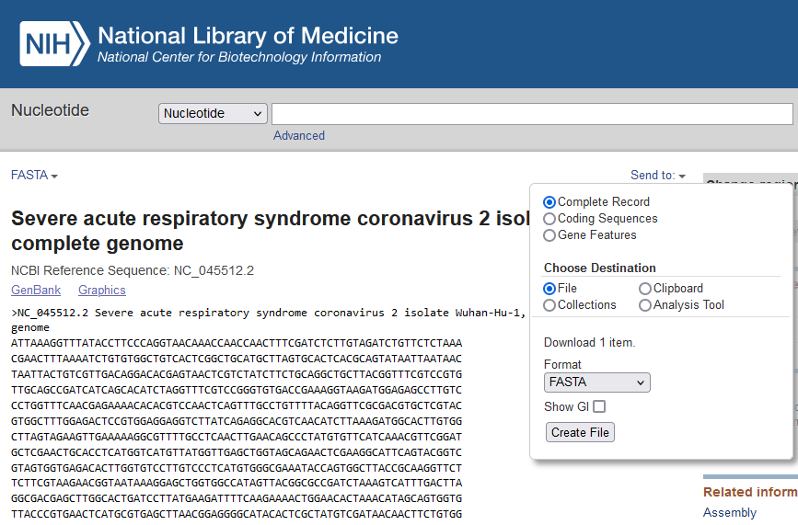
Abyss Tutorial

Slide 51
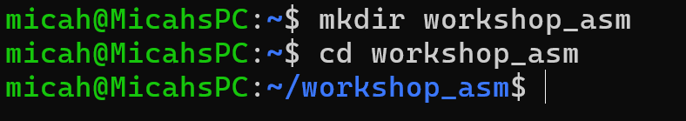
Abyss tutorial
Create working directory for assembly under home

Slide 52
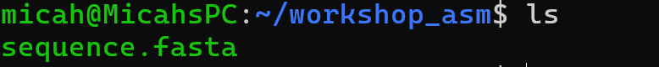
Abyss tutorial
Move the downloaded genome file to this directory:
cp /mnt/c/Users/windows_username/Downloads/sequence.fasta .
NOTE: Change windows_username to your windows username
Verify file moved with ‘ls’

Slide 53
Abyss tutorial
Install python for simulating reads from genome file (this may take a minute [73 Mb])
sudo apt-get install python3
Install pip package manager for python
sudo apt-get install pip

Slide 54
Abyss tutorial
Install Biopython for dependencies
sudo pip install biopython
Retrieve python script
wget https://raw.githubusercontent.com/mathornton01/twupa_bioinformaticsws_2024/main/tools/sample_fasta.py

Slide 55
Abyss tutorial
Sample the Coronavirus genome
python3 sample_fasta.py sequence.fasta 1000000 100 300 simsam
Check simulated samples with
head simsam_R1.fasta
head simsam_R2.fasta

Slide 56
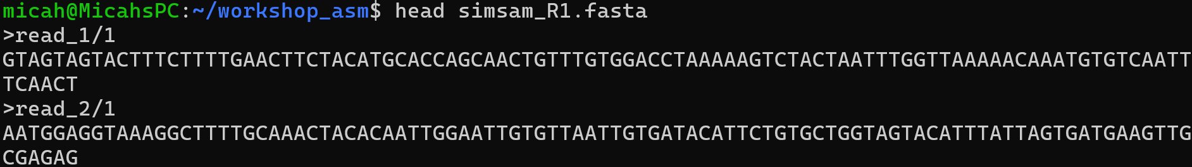
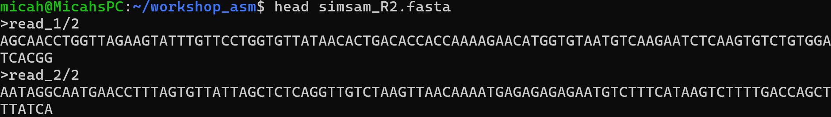
Abyss Tutorial

Slide 57
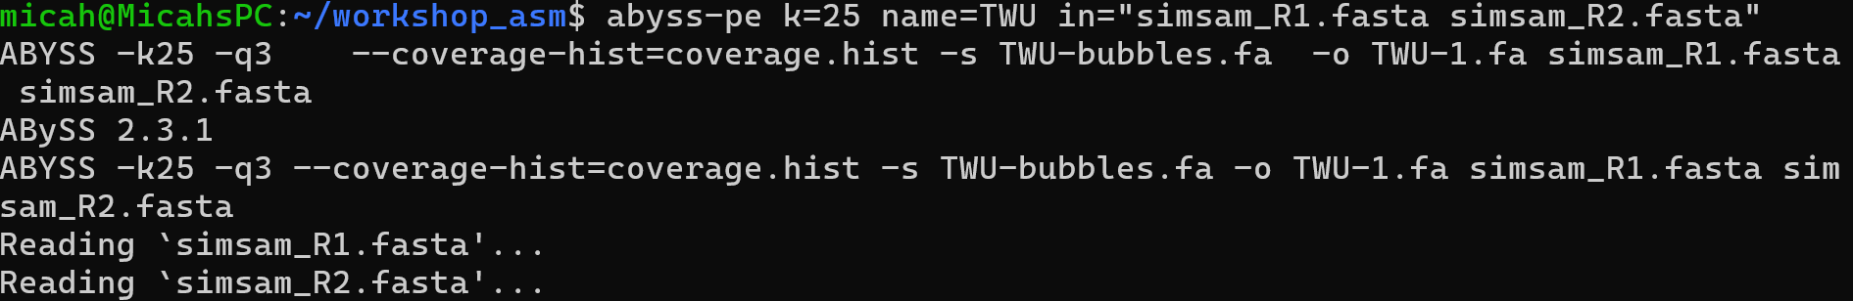
Abyss Tutorial
Run abyss-pe on simulated reads.
abyss-pe k=25 name=TWU in="simsam_R1.fasta simsam_R2.fasta“

Slide 58
Abyss Tutorial
Check output in file TWU-1.fa

Slide 59
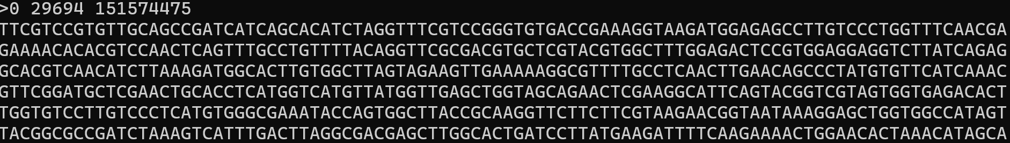
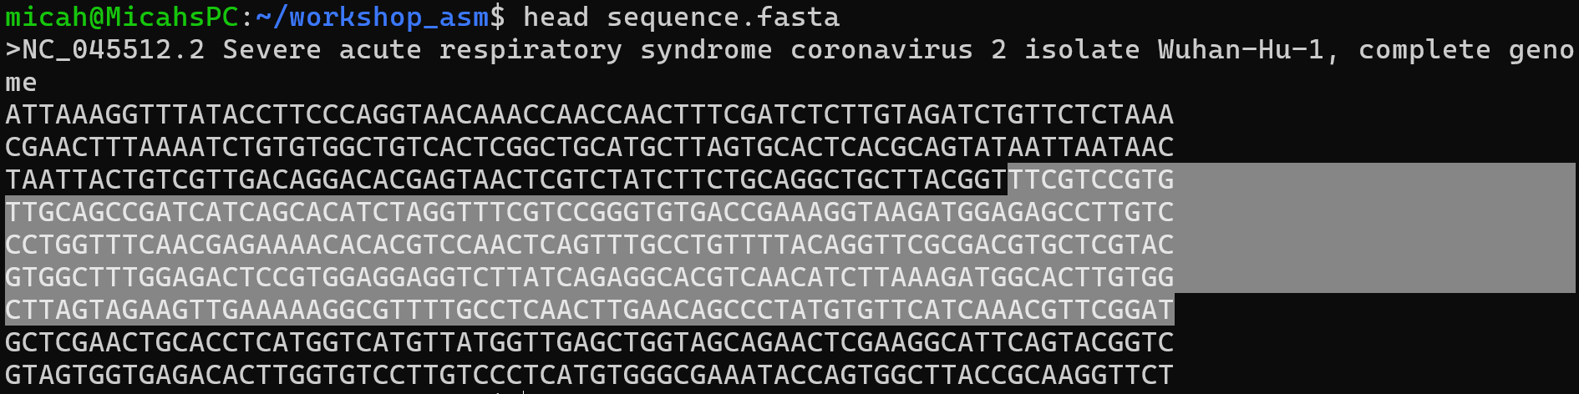
Abyss Tutorial

Slide 60
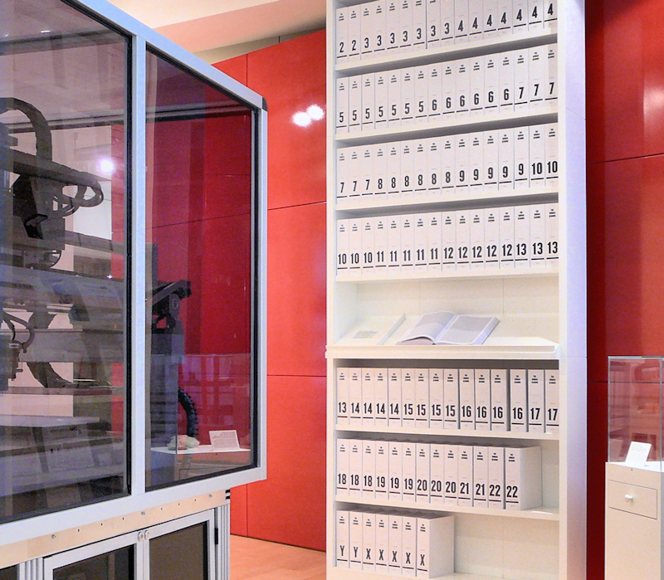
Human Reference Genome
The human reference genome (GRCh38) is a complete assembly of the human genome
It is a haploid representation of a diploid sequence.
It is comprised of the DNA from eight people
One individual accounts for 66 % of the DNA.
Contains the O allele for ABO blood group (but others are annotated).
Can be accessed and downloaded here:
https://www.ncbi.nlm.nih.gov/datasets/genome/GCF_000001405.26/
Approximately 3.2 GB in size.
By Russ London at English Wikipedia, CC BY-SA 3.0, https://commons.wikimedia.org/w/index.php?curid=9923576

Slide 61
Standard FASTA Format
FASTA stands for Fast-All
All refers to any possible sequence of Latin or Alphanumeric/Special characters
Utilizes standard “alphabets” for protein sequences or genetic sequences

Slide 62
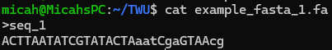
FASTA Format
Starts label lines with “>” followed by the label of the subsequent sequence.
Basis for the fasta-quality files we will discuss next

Slide 63
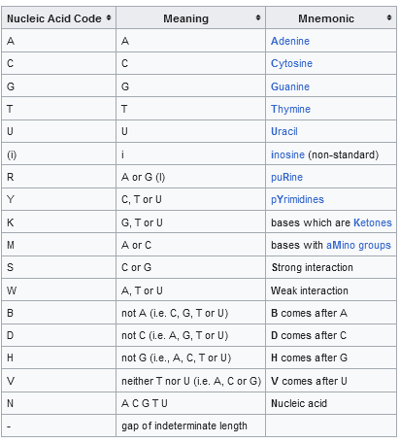
FASTA Format - Genes
Nucleic Acid Codes contain more than just ACGTU
Can be upper or lower case – meaning differs
Lower case – can indicated low-confidence calls or masked bases

Slide 64
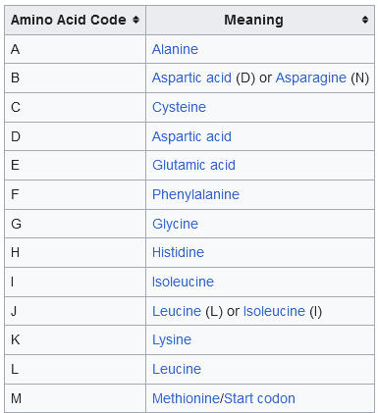
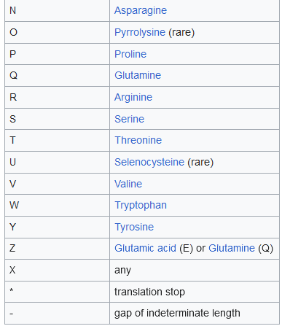
FASTA Format – Proteins

Slide 65
FASTQ Format - Quality
Instead of 2 lines per sequence has 4 lines
Line 1 starts with @ and has Sequence ID
Line 2 Contains the sequence
Line 3 is + just as a separator
Line 4 contains quality information stored as ASCII character where 0x21 (!) is lowest quality and 0x7e (~) is highest

Slide 66
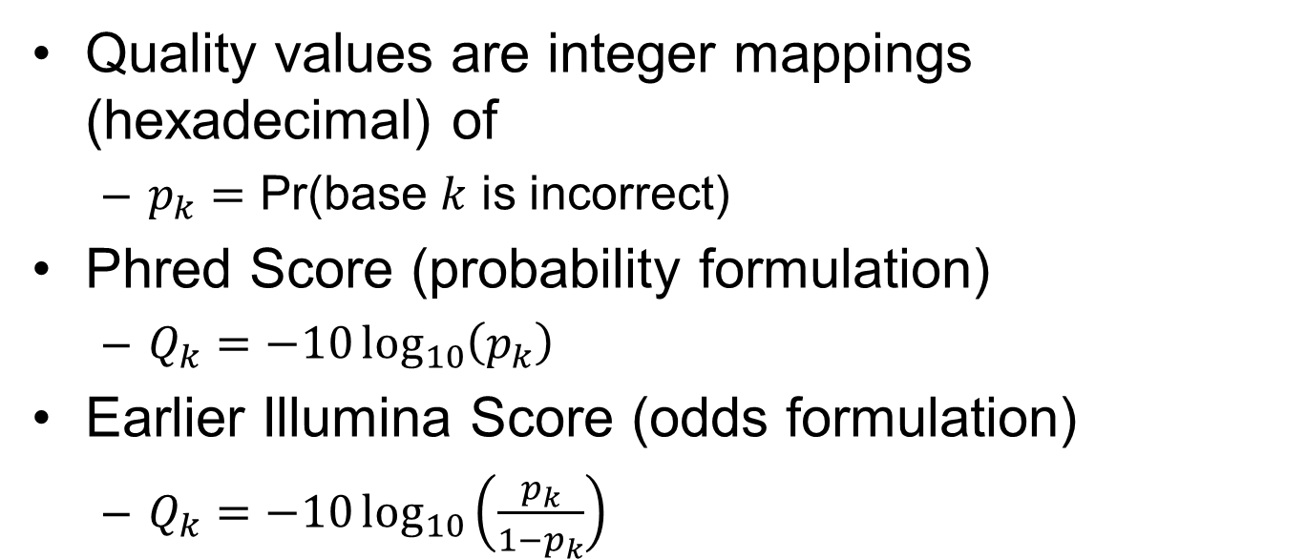
FASTQ quality (Phred Scores)
Quality values are integer mappings (hexadecimal) of
$p_{k}=$ Pr(base $k$ is incorrect)
Phred Score (probability formulation)
$Q_{k}=−10\log_{10}\left(p_{k}\right)$
Earlier Illumina Score (odds formulation)
$Q_{k}=−10\log_{10}\left(\frac{p_{k}}{1−p_{k}}\right)$

Slide 67
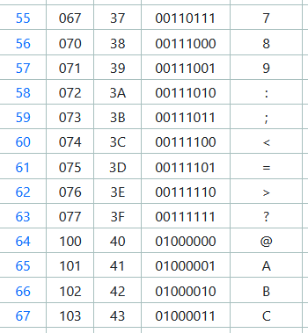
Break-out Session 1 – Quality Scores
Using the probability formulation, what is the probability of an incorrect base at a PHRED score of ‘;’?
Using the odds formulation?

Slide 68
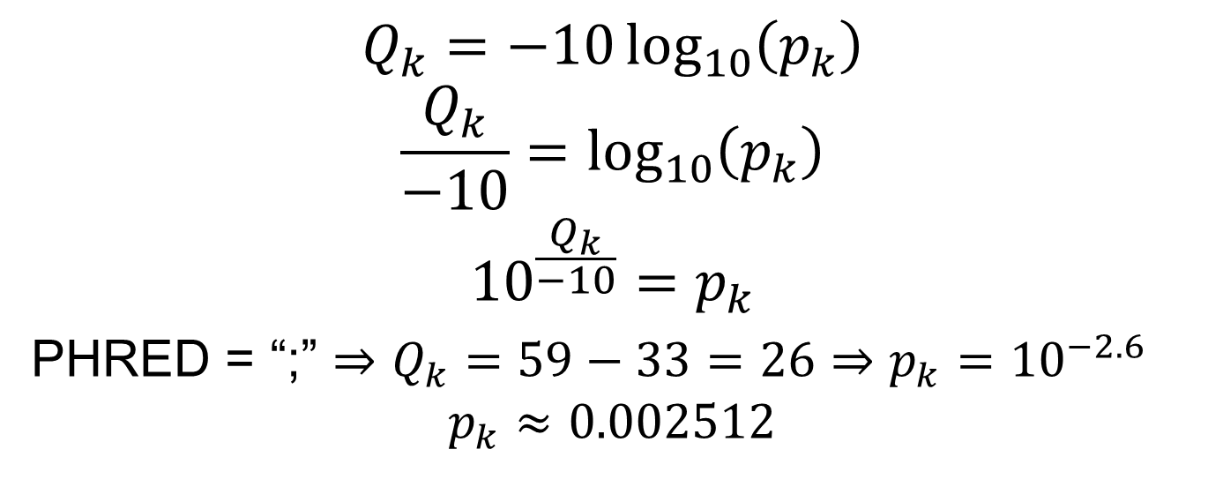
Quality Scores
$$Q_{k}=−10\log_{10}\left(p_{k}\right)$$
$$\frac{Q_{k}}{−10}=\log_{10}\left(p_{k}\right)$$
$${10}^{\frac{Q_{k}}{−10}}=p_{k}$$
PHRED = “;” $⇒Q_{k}=59−33=26⇒p_{k}={10}^{−2.6}$
$$p_{k}≈0.002512$$

Slide 69
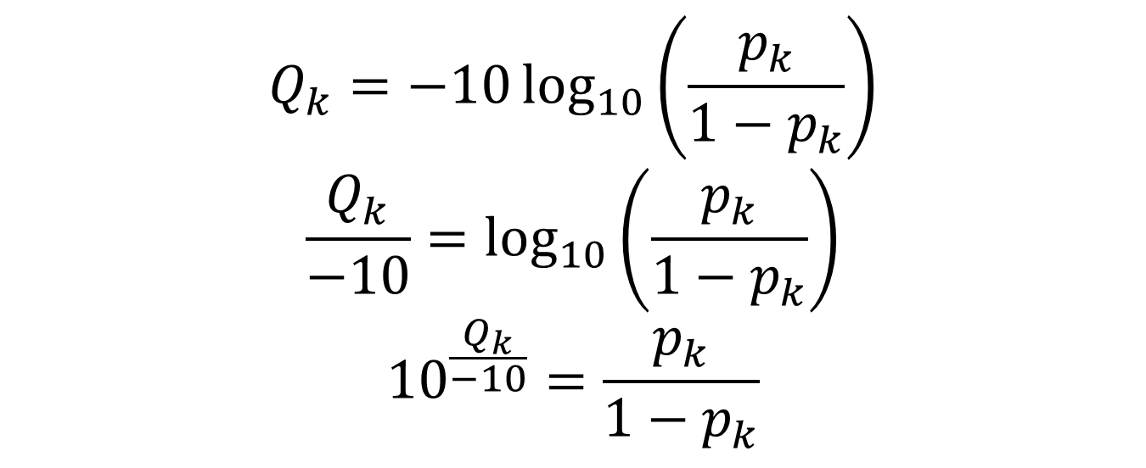
Quality Scores
$$Q_{k}=−10\log_{10}\left(\frac{p_{k}}{1−p_{k}}\right)$$
$$\frac{Q_{k}}{−10}=\log_{10}\left(\frac{p_{k}}{1−p_{k}}\right)$$
$${10}^{\frac{Q_{k}}{−10}}=\frac{p_{k}}{1−p_{k}}$$

Slide 70
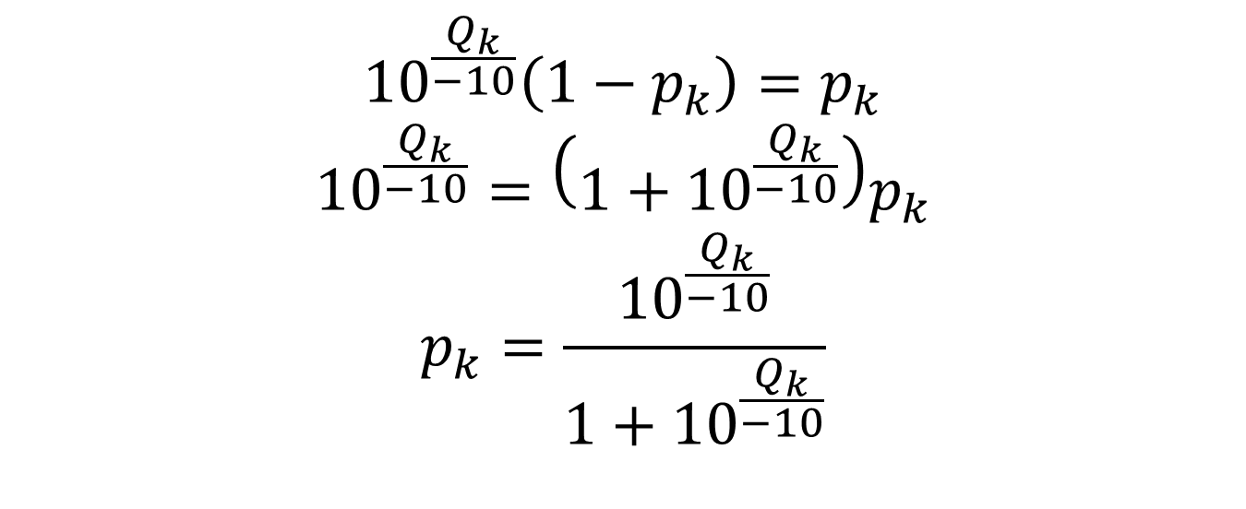
Quality Scores
$${10}^{\frac{Q_{k}}{−10}}\left(1−p_{k}\right)=p_{k}$$
$${10}^{\frac{Q_{k}}{−10}}=\left(1+{10}^{\frac{Q_{k}}{−10}}\right)p_{k}$$
$$p_{k}=\frac{{10}^{\frac{Q_{k}}{−10}}}{1+{10}^{\frac{Q_{k}}{−10}}}$$

Slide 71
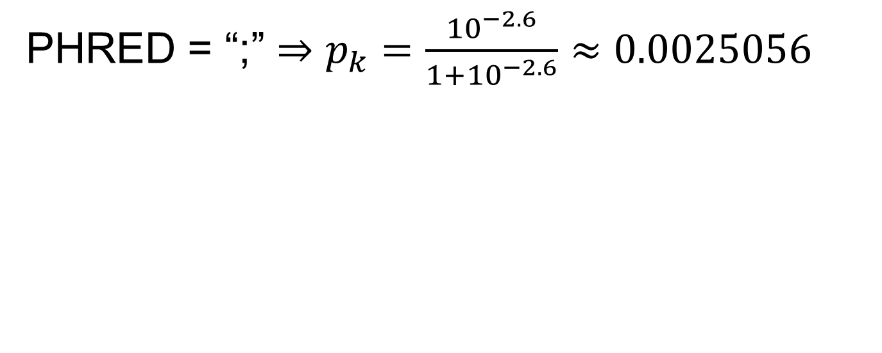
Quality Scores
PHRED = “;” $⇒p_{k}=\frac{{10}^{−2.6}}{1+{10}^{−2.6}}≈0.0025056$

Slide 72
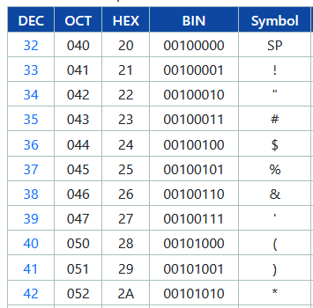
Quality Scores
Probability formulation at “!”
Odds formulation?

Slide 73
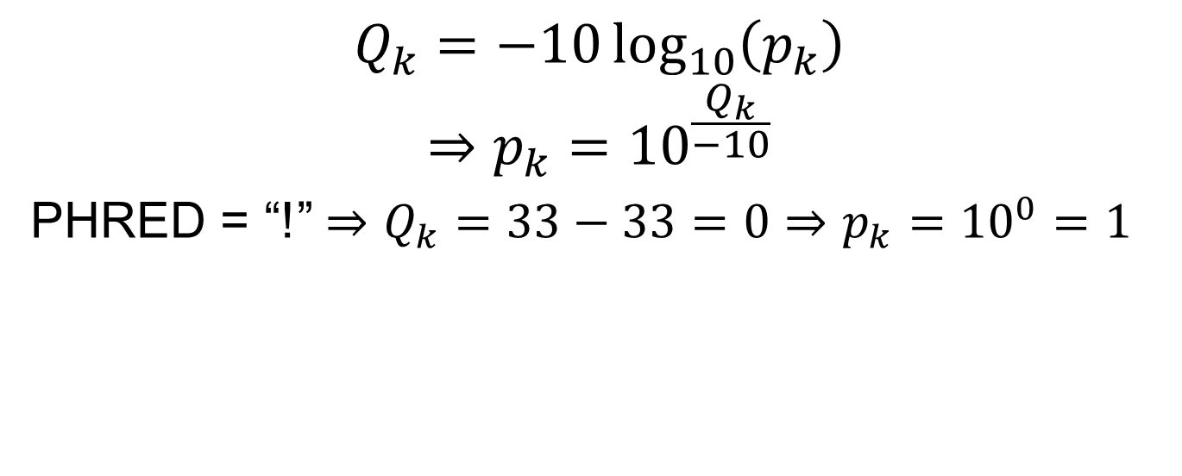
Quality Scores
$$Q_{k}=−10\log_{10}\left(p_{k}\right)$$
$$⇒p_{k}={10}^{\frac{Q_{k}}{−10}}$$
PHRED = “!” $⇒Q_{k}=33−33=0⇒p_{k}={10}^{0}=1$

Slide 74
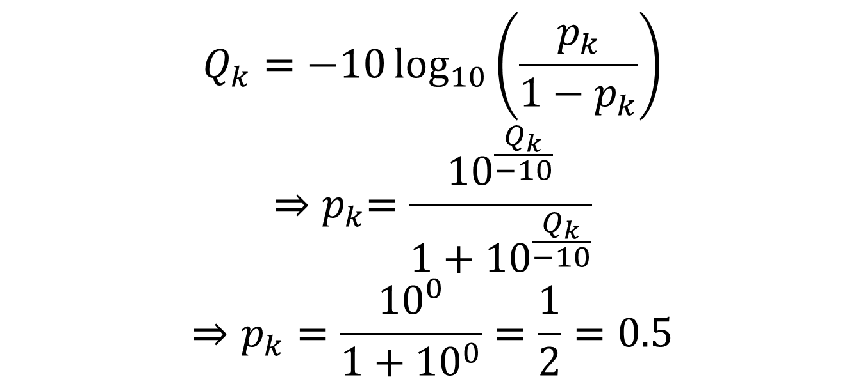
Quality Scores
$$Q_{k}=−10\log_{10}\left(\frac{p_{k}}{1−p_{k}}\right)$$
$${⇒p}_{k}=\frac{{10}^{\frac{Q_{k}}{−10}}}{1+{10}^{\frac{Q_{k}}{−10}}}$$
$$⇒p_{k}=\frac{{10}^{0}}{1+{10}^{0}}=\frac{1}{2}=0.5$$

Slide 75
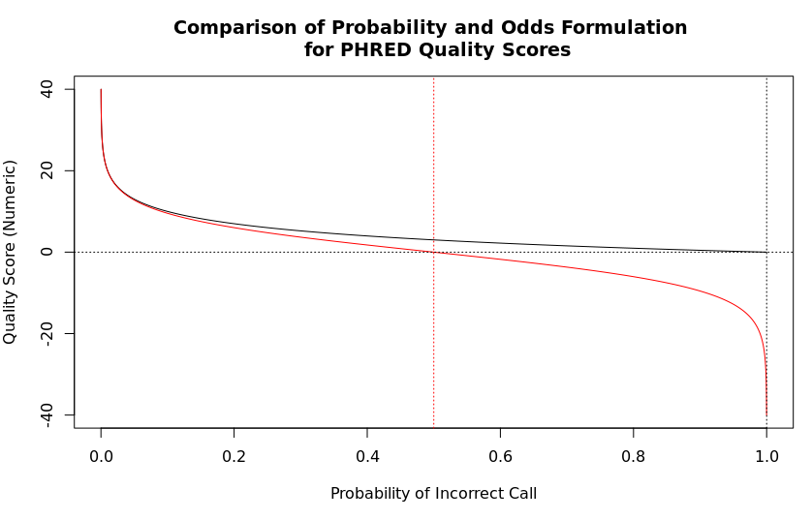
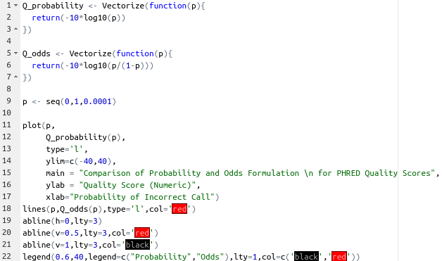
Quality Scores

Slide 76
Break (10 min)

Slide 77
Sequence Alignment Maps
SAM Files are Sequence Alignment Maps
They are Tab-separated Files
The fields of SAM files are well defined.
SAM files are the output of alignment steps
SAM files tell you where each read in a read file maps to a genome from a genome file

Slide 78
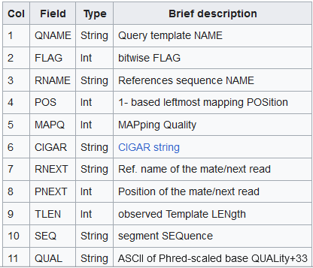
Sequence Alignment Maps
Each field contains vital information about the alignment of a given read from a read file

Slide 79
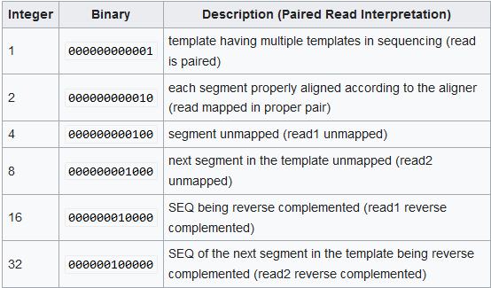
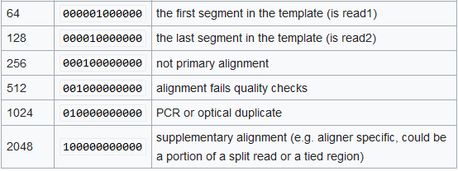
Sequence Alignment Maps - Flags
FLAGS are field 2, displayed as integer

Slide 80
Sequence Alignment Maps - FLAGS
Suppose 2145 is provided as the flag on a line.
Convert 2145 from Base 10 to Base 2 (Binary)

Slide 81
Sequence Alignment Maps - FLAGS
Recall: Conversion of base 10 to base 2 requires repeated division by 2.

Slide 82
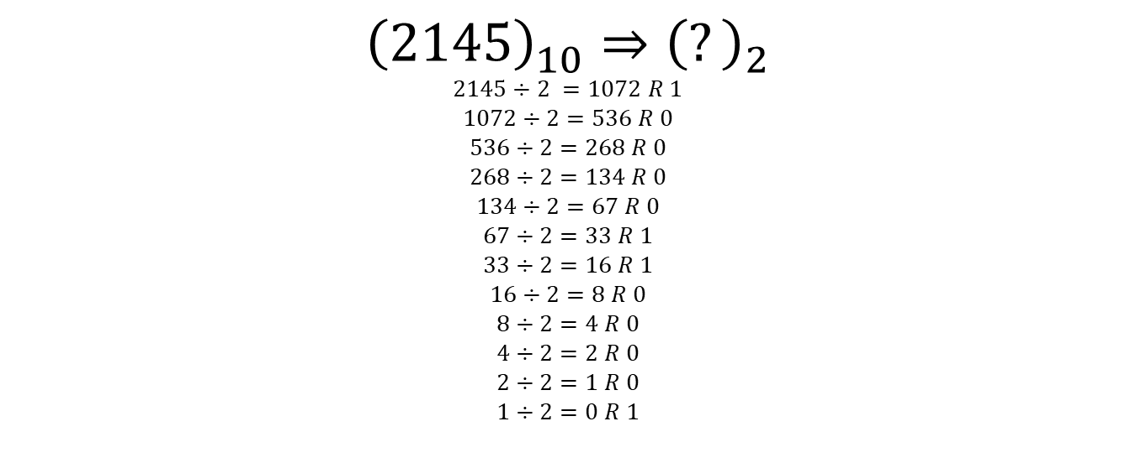
Sequence Alignment Maps - FLAGS
$${\left(2145\right)}_{10}⇒{\left(?\right)}_{2}$$
$$2145÷2 =1072 R 1$$
$$1072÷2=536 R 0$$
$$536÷2=268 R 0$$
$$268÷2=134 R 0$$
$$134÷2=67 R 0$$
$$67÷2=33 R 1$$
$$33÷2=16 R 1$$
$$16÷2=8 R 0$$
$$8÷2=4 R 0$$
$$4÷2=2 R 0$$
$$2÷2=1 R 0$$
$$1÷2=0 R 1$$

Slide 83
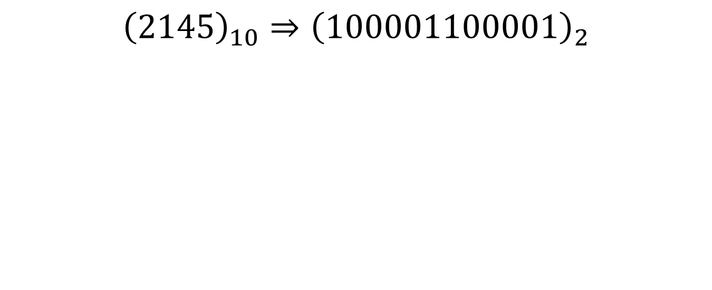
Sequence Alignment Maps - FLAGS
$${\left(2145\right)}_{10}⇒{\left(100001100001\right)}_{2}$$

Slide 84
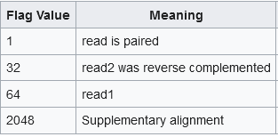
Sequence Alignment Map - FLAGS
$${\left(2145\right)}_{10}⇒{\left(100001100001\right)}_{2}$$

Slide 85

FLAGS
Please describe a read that has FLAG ${\left(1683\right)}_{10}$

Slide 86
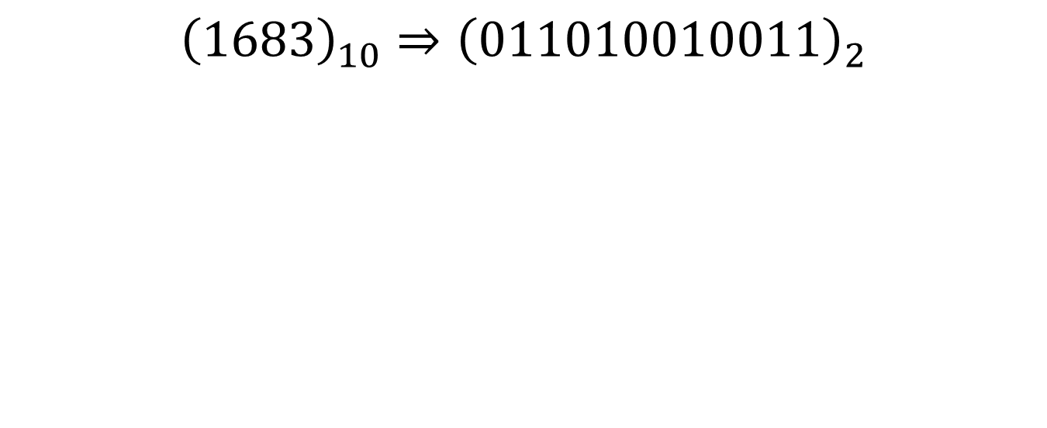
FLAGS
$${\left(1683\right)}_{10}⇒{\left(011010010011\right)}_{2}$$

Slide 87
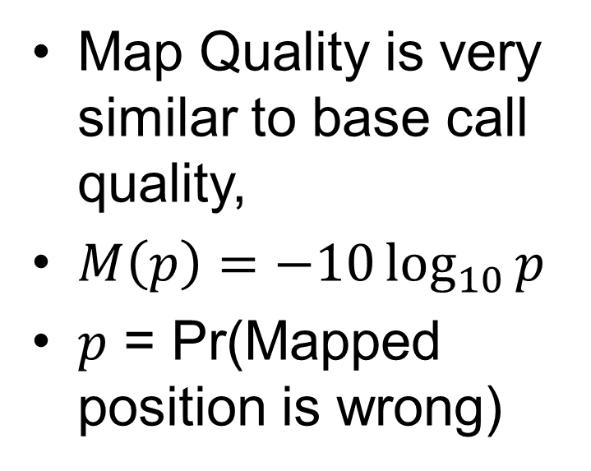
Sequence Alignment Maps - MAPQ
Map Quality is very similar to base call quality,
$M\left(p\right)=−10\log_{10}{p}$
$p$ = Pr(Mapped position is wrong)

Slide 88
Sequence Alignment Maps - CIGAR
CIGAR Describes how the sequence maps to the given location
Concise Idiosyncratic Gapped Alignment Report

Slide 89


Sequence Alignment Maps - CIGAR
Soft clipping retains unaligned portion of read from SAM
Hard clipping removes unaligned portion of read from SAM

Slide 90
CIGAR
Suppose we have the following rather poor alignment, please write down the CIGAR string you would find in the SAM file.
REF: AGCATTACGATACTA
READ: gggATTA---TAggg

Slide 91
CIGAR
REF: AGCATTACGATACTA
READ: gggATTA---TAggg
3S4M3D2M3S
3S – three bases softclipped at beginning of read
4M – four matches
3D – 3 Deletions
2M – two matches
3S – three bases softclipped at end of read

Slide 92
Sequence Alignment Maps - BAM
The sequence alignment map can be binarized to save room (that is converted into a completely binary file).

Slide 93

BAM Specification

Slide 94

BAMFile Index
Questions:
1) What is the bin number for an alignment spanning [90k,99k]
2) [30k,39k]?
3) [0,9k]?

Slide 95

Sequence Alignment Maps - BAI
From SAM Format Specification:
https://samtools.github.io/hts-specs/SAMv1.pdf

Slide 96



The Broad Institute Integrative Genomics Viewer
Developed and Maintained by the Broad Institute:
A Joint Institute of Harvard and MIT.
Founded in 2004 (from organizational remnants of the Human Genome Project) for the purposes of [from https://www.broadinstitute.org/about-us ]:
“Illuminating Human Disease”
“Reading and Editing Genomes”
“Sharing Data and Tools”
“Building Communities”
“Developing Diagnostics and Treatments”
“Collaborating, Innovating, and Empowering”
Integrative Genomics Viewer (IGV) is a software environment for analyzing NGS data
Provided and maintained by The Broad Institute, with IGV team based at UC San Diego, and MIT/Harvard Broad Institute.
Supported by funding from:
The National Cancer Institute (NCI)
The National Institutes of Health (NIH)
Informatics Technology for Cancer Research (ITCR)
Starr Cancer Consortium
Written in Java, hence allowing use of platform independent jvm.
From Robinson, J., Thorvaldsdóttir, H., Winckler, W. et al. Integrative genomics viewer. Nat Biotechnol 29, 24–26 (2011). https://doi.org/10.1038/nbt.1754

Slide 97




Slide 98


Slide 99


Slide 100


Slide 101


Slide 102


Slide 103


Slide 104


Slide 105


Slide 106


Slide 107


Slide 108


Slide 109


Slide 110


Slide 111


Slide 112


Slide 113


Slide 114


Slide 115
IGV Tutorial
Now we are going to work with IGV to investigate a sample.
SRA Toolkit helps to download samples easily

Slide 116

IGV Tutorial
Download the .bam and .bai alignment files by opening a terminal window and typing the following command in
wget https://github.com/mathornton01/twupa_bioinformaticsws_2024/raw/main/data/bamfiles/eyes_1.zip
Extract the zipped bamfiles folder with
unzip eyes_1.zip
Open IGV and load the Hg38 human genome reference (you should have this downloaded already)

Slide 117

IGV Tutorial
Load the eyes_exercise_1.bam file (note that the .bai index file must be in the same directory as the .bam file)

Slide 118

IGV Tutorial
Select the eyes_exercise_1.bamfile (you may have to navigate to the appropriate directory [linux])

Slide 119

IGV Tutorial
You should now see the coverage and alignment tracks for the eyes_exercise_1.bam file

Slide 120

IGV Tutorial
This table will help us Identify the eye color of the individual from whom the eye_exercise_1.bam file was taken.

Slide 121

IGV Tutorial
We need to identify where the SNPs for these given SNP IDs are located in GRCh38

Slide 122
IGV Tutorial
Let us identify where the SNP corresponding to ID: “rs12913832” is located.

Slide 123

IGV Tutorial
Visit the website: https://www.ncbi.nlm.nih.gov

Slide 124

IGV Tutorial
Select SNP from the dropdown menu

Slide 125

IGV Tutorial
Type the SNP ID we are trying to identify (rs12913832) into the search bar.

Slide 126

IGV Tutorial
Collect the location and allelic variant information from this page.
Position- 15:28120472
Variants- A>C/G

Slide 127

IGV Tutorial
Return to IGV, and type this location into the search bar at the top of the application window then press “Go”.

Slide 128

IGV Tutorial
Select the dual-colored coverage histogram indicator in the coverage track for information about the sample.

Slide 129

IGV Tutorial
What would you guess was the genotype of this individual? (A/G)
What does this indicate about the individual according to our table?

Slide 130

IGV Tutorial
Which SNP should we check next?
How about rs12203592?
What is the most likely eye color for this person?

Slide 131
Minor Allele Frequency
Minor Allele Frequency (MAF) is an important value in genomic studies.
Each read indicates one allele (for haploid organisms there is only one allele in the sample)
For polyploid (diploid and higher ploidy) there can be up to four possible alleles.

Slide 132
Minor Allele Frequency
In a given population the frequency of the least commonly occurring allele is known as the minor allele frequency.

Slide 133
Minor Allele Frequency
Suppose we observe the following haplotypes in the population.
[AT, TT, TT, TT, TA, AA, TA]
To calculate the MAF, we must first identify the number of A and T in the sample
There are 5 A, and 9 T, for a total of 14 Bases.
The minor Allele for this particular SNP then would be A, and the MAF is 5/14 which is a little less than 1/3.

Slide 134
Minor Allele Frequency
The Multinomial distribution is a distribution on categorical values.
Just as the binomial distribution is a distribution on two values (usually represented 0, and 1)

Slide 135

Minor Allele Frequency
Suppose we have a random variable $A_{i}$, (usually random variables are represented by capital Latin characters)
Let the support of $A_{i}$ be denoted symbolically by the set $𝒮_{A}$,
If $A_{i}$ is defined as the allele observed at position $p$ of the $i$th read in a sample of $N$ reads, we may write $𝒮_{A}$ as $\{\text{A}\text{,}\text{C}\text{,}\text{G}\text{,}\text{T}\text{\}}$.
Now let us define $π_{j}$ as the probability that $A_{i}=j$ for $j∈𝒮_{A}$

Slide 136

Minor Allele Frequency
Now let us assume $A_{i}\overset{IID}{∼} (π)$, that is $A_{i}$ are distributed identically and independently according to the parameter $π={\left[π_{A},π_{C},π_{G},π_{T}\right]}^{T}$

Slide 137

Minor Allele Frequency
Suppose the vector random variable
$A={\left[A_{1},A_{2},…,A_{N}\right]}^{T}$
Takes on valuation
$a={\left[a_{1},a_{2},…,a_{N}\right]}^{T}$ for $a_{i}∈𝒮_{A}$
For a given read $i$ we then have
$\operatorname{Pr}\left(A_{i}=a_{i}\right)=π_{A}^{𝟙\left(a_{i}≡\text{A}\right)}π_{C}^{𝟙\left(a_{i}≡\text{C}\right)}π_{G}^{𝟙\left(a_{i}≡\text{G}\right)}$ $π_{T}^{𝟙\left(a_{i}≡\text{T}\right)}$

Slide 138

Minor Allele Frequency
Here $𝟙(⋅)$ = 1 if $⋅$ is True, otherwise 0 if False.
Now suppose we are interested in the number of reads that indicate the base at position $p$ is “A”.
$C_{B}=\sum_{\left\{i=1\right\}}^{N}{𝟙\left(A_{i}=\text{B}\right)}$

Slide 139

Minor Allele Frequency
Suppose that the coverage is 2x, therefore 2 reads cover position $p$,
Symbolically $N=2$,
$C_{\text{A}},C_{\text{C}},C_{\text{G}},C_{\text{T}}$ may take on only the values 0, 1 or 2.
$C=\left[C_{\text{A}},C_{\text{C}},C_{\text{G}},C_{\text{T}}\right]$ then can only take on values such that its sum is 0,1, or 2.

Slide 140

Minor Allele Frequency
$C∈$
$\left[0,0,0,2\right],\left[0,0,2,0\right],\left[0,2,0,0\right],\left[2,0,0,0\right]$
[0,0,1,1],[0,1,0,1],[1,0,0,1]
[0,1,1,0],[1,0,1,0],
[1,1,0,0]

Slide 141

Minor Allele Frequency
Say we have two reads $r_{1},r_{2}$ Then $C$ takes on values according to the following
$\left[0,0,0,r_{1}\&r_{2}\right],\left[0,0,r_{1}\&r_{2},0\right],\left[0,r_{1}\&r_{2},0,0\right],\left[r_{1}\&r_{2},0,0,0\right]$
{[0,0,$r_{1}$, $r_{2}$], [0,0,$r_{2}$, $r_{1}$]},{[0, $r_{2}$,0, $r_{1}$], [0, $r_{1}$,0, $r_{2}$]},{[$r_{2}$,0,0,$r_{1}$], [$r_{1}$,0,0,$r_{2}$]}
{[0,$r_{1},r_{2}$,0], [0,$r_{2},r_{1}$,0]}, {[$r_{2}$,$r_{1},0$,0], [$r_{1}$,$r_{2},$0,0]},
{[$r_{1},r_{2},0,0],[r_{2},r_{1},0,0]$}

Slide 142

Minor Allele Frequency
Let’s work out the probability for each:
$\operatorname{Pr}\left(C=\left[0,0,0,2\right]\right)=\left(1\right)⋅π_{\text{T}}^{2}$
$\operatorname{Pr}\left(C=\left[0,0,2,0\right]\right)=\left(1\right)⋅π_{\text{G}}^{2}$
$\operatorname{Pr}\left(C=\left[0,2,0,0\right]\right)=\left(1\right)⋅π_{\text{C}}^{2}$
$\operatorname{Pr}\left(C=\left[2,0,0,0\right]\right)=\left(1\right)⋅π_{\text{A}}^{2}$

Slide 143

Minor Allele Frequency
Let’s work out the probability for each:
$\operatorname{Pr}\left(C=\left[0,0,1,1\right]\right)=π_{\text{T}}^{1}π_{\text{G}}^{1}+π_{\text{G}}^{1}π_{\text{T}}^{1}=\left(2\right)⋅π_{\text{T}}^{1}π_{\text{G}}^{1}$
$\operatorname{Pr}\left(C=\left[0,1,0,1\right]\right)=π_{\text{T}}^{1}π_{\text{C}}^{1}+π_{\text{C}}^{1}π_{\text{T}}^{1}=\left(2\right)⋅π_{\text{T}}^{1}π_{\text{C}}^{1}$
$\operatorname{Pr}\left(C=\left[1,0,0,1\right]\right)=π_{\text{T}}^{1}π_{\text{A}}^{1}+π_{\text{G}}^{1}π_{\text{A}}^{1}=\left(2\right)⋅π_{\text{T}}^{1}π_{\text{A}}^{1}$

Slide 144

Minor Allele Frequency
Let’s work out the probability for each:
$\operatorname{Pr}\left(C=\left[0,1,1,0\right]\right)=π_{\text{C}}^{1}π_{\text{G}}^{1}+π_{\text{G}}^{1}π_{\text{C}}^{1}=\left(2\right)⋅π_{\text{C}}^{1}π_{\text{G}}^{1}$
$\operatorname{Pr}\left(C=\left[1,0,1,0\right]\right)=π_{\text{A}}^{1}π_{\text{G}}^{1}+π_{\text{G}}^{1}π_{\text{A}}^{1}=\left(2\right)⋅π_{\text{G}}^{1}π_{\text{A}}^{1}$
$\operatorname{Pr}\left(C=\left[1,1,0,0\right]\right)=π_{\text{C}}^{1}π_{\text{A}}^{1}+π_{\text{C}}^{1}π_{\text{A}}^{1}=\left(2\right)⋅π_{\text{C}}^{1}π_{\text{A}}^{1}$

Slide 145

Minor Allele Frequency
In general for $N$ reads we can write:
$\operatorname{Pr}{(}C=\left[C_{\text{A}},C_{\text{C}},C_{\text{G}},C_{\text{T}}\right]=\left[c_{\text{A}},c_{\text{C}},c_{\text{G}},c_{\text{T}}\right])=$
$\frac{N!}{c_{\text{A}}!c_{\text{C}}!c_{\text{G}}!c_{\text{T}}!}π_{\text{A}}^{\left\{c_{\text{A}}\right\}}π_{\text{C}}^{\left\{c_{\text{C}}\right\}}$ $π_{\text{G}}^{\left\{c_{\text{G}}\right\}}$ $π_{\text{T}}^{\left\{c_{\text{T}}\right\}}$
And $c_{\text{A}}+c_{\text{C}}+c_{\text{G}}+c_{\text{T}}=N$
And Say $C∼\text{MN}(π)$ ($C$ is distributed multinomially with parameter $π.)$

Slide 146
Minor Allele Frequency
We are interested in the distribution of the minimum category
Turns out, this is possibly impossible to specify analytically
We can simulate the distribution though!

Slide 147



Minor Allele Frequency
$$π=\left[0.2,0.3,0.3,0.2\right],$$
$$n=10000$$

Slide 148


Minor Allele Frequency
$$π=\left[0.25,0.25,0.25,0.25\right],$$
$$n=100000$$

Slide 149


Maximum Allele Frequency
$$π=\left[0.25,0.25,0.25,0.25\right],$$
$$n=100000$$

Slide 150
Allelic Frequencies
Open problem to characterize distribution of minimum for uniform probabilities, or to find stricter boundaries for it.

Slide 151


Fitting distributions
Question:
How do the corresponding parameters (number of bins, and number of observations) relate to the parameters of the Weibull Distribution?

Slide 152
Back to IGV
Download the following file
wget https://github.com/mathornton01/twupa_bioinformaticsws_2024/raw/main/data/bamfiles/eth_1.zip
Use what you have learned so far to look up and write down the alleles for each of the following SNPs.
Then guess what the most likely ethnicity of the person is from the graphic.

Slide 153



Huang et al. Ethnicity SNP Exercise.
https://bmcgenomics.biomedcentral.com/articles/10.1186/s12864-015-2328-0
rs6023406
https://www.ncbi.nlm.nih.gov/snp
Search for SNP name, get info about location and variants! Including location. (chr20:54603422)
Huang, T., Shu, Y. & Cai, YD. Genetic differences among ethnic groups. BMC Genomics 16, 1093 (2015). https://doi.org/10.1186/s12864-015-2328-0

Slide 154


Slide 155

Branicki et al. Hair-Color SNP Exercise.
https://www.ncbi.nlm.nih.gov/pmc/articles/PMC3057002/
Probably a good idea to check those statistically significant variants first.
Branicki, Wojciech et al. “Model-based prediction of human hair color using DNA variants.” Human genetics vol. 129,4 (2011): 443-54. doi:10.1007/s00439-010-0939-8
Download the read data for human genome 138 here:
wget https://github.com/mathornton01/twupa_bioinformaticsws_2024/raw/main/data/bamfiles/hg138.zip
Determine the haircolor, ethnicity, and eye color if you have time.

Slide 156
Spichenok et al. Eye-Color SNP Exercise.
https://www.sciencedirect.com/science/article/pii/S1872497310001717?via%3Dihub
Spichenok O, Budimlija ZM, Mitchell AA, Jenny A, Kovacevic L, Marjanovic D, Caragine T, Prinz M, Wurmbach E. Prediction of eye and skin color in diverse populations using seven SNPs. Forensic Sci Int Genet. 2011 Nov;5(5):472-8. doi: 10.1016/j.fsigen.2010.10.005. Epub 2010 Nov 2. PMID: 21050833.

Slide 157
Resources on this section:
IGV video Tutorials.
https://www.youtube.com/watch?v=E_G8z_2gTYM
IGV Manual, and Installation Tutorial
https://software.broadinstitute.org/software/igv/UserGuide
Broad Institute Website
https://www.broadinstitute.org/
Papers for Exercises
Ethnicity -https://bmcgenomics.biomedcentral.com/articles/10.1186/s12864-015-2328-0
Hair-Color - https://www.ncbi.nlm.nih.gov/pmc/articles/PMC3057002/
Eye-Color - https://www.sciencedirect.com/science/article/pii/S1872497310001717?via%3Dihub
Databases
NCBI - https://www.ncbi.nlm.nih.gov/
SNP - https://www.ncbi.nlm.nih.gov/snp/
SRA - https://www.ncbi.nlm.nih.gov/sra/

Slide 158
BLAST Tutorial
Go to this website for the MTHFR Genetic Sequence assembly (from GRCh38).
https://www.ncbi.nlm.nih.gov/nuccore/NC_000001.11?report=fasta&from=11785723&to=11805964&strand=true
Highlight the sequence and copy it.

Slide 159

BLAST
Visit this website:
https://blast.ncbi.nlm.nih.gov/Blast.cgi

Slide 160

BLAST
Select Nucleotide BLAST, we will be comparing the gene MTHFR from the reference genome to other species.

Slide 161

BLAST
Paste the sequence you copied into the box at the top of the page, then
Press BLAST at the bottom of the page.

Slide 162
BLAST
Many options are available through the web application interface.
BLAST is also available as a commandline tool, but this is just really an interface to the online application.

Slide 163

BLAST
To install the commandline application open a powershell type ‘wsl’ then type “sudo apt-get install ncbi-blast+”

Slide 164
BLAST
BLAST requires a database to search against and a query file, or you can send the search to the remote database.
Create a new .fasta file called mthfr.fasta by typing touch mthfr.fasta.

Slide 165
BLAST
Open the file in the vim text editor by typing vim mthfr.fasta.
Press “i” to enter insert mode
Then paste the sequence
PRESS escape and then type “:wq” and presss enter.

Slide 166
BLAST
Now type:
“blastn -db nt -query mthfr.fasta -o
ut results.out –remote”

Slide 167

BLAST
Results are written to the file results.out in the multiple alignment format,

Slide 168

BLAST
To see all the sequences that it aligned to type “grep “^>” results.out”

Slide 169
BLAST
Identify possible sources of the following sequence using blastn with the remote nt database:
AATATGGTGATTGCCTTGGTGATATTGCTGCTAGAGACCTCATTTGTGCACAAAAGTTTAACGGCCTTAC TGTTTTGCCACCTTTGCTCACAGATGAAATGATTGCTCAATACACTTCTGCACTGTTAGCGGGTACAATC ACTTCTGGTTGGACCTTTGGTGCAGGTGCTGCATTACAAATACCATTTGCTATGCAAATGGCTTATAGGT TTAATGGTATTGGAGTTACACAGAATGTTCTCTATGAGAACCAAAAATTGATTGCCAACCAATTTAATAG TGCTATTGGCAAAATTCAAGACTCACTTTCTTCCACAGCAAGTGCACTTGGAAAACTTCAAGATGTGGTC AACCATAATGCACAAGCTTTAAACACGCTTGTTAAACAACTTAGCTCCAAATTTGGTGCAATTTCAAGTG TTTTAAATGATATCCTTTCACGTCTTGACAAAGTTGAGGCTGAAGTGCAAATTGATAGGTTGATCACAGG CAGACTTCAAAGTTTGCAGACATATGTGACTCAACAATTAATTAGAGCTGCAGAAATCAGAGCTTCTGCT AATCTTGCTGCTACTAAAATGTCAGAGTGTGTACTTGGACAATCAAAAAGAGTTGATTTTTGTGGAAAGG GCTATCATCTTATGTCCTTCCCTCAGTCAGCACCTCATGGTGTAGTCTTCTTGCATGTGACTTATGTCCC TGCACAAGAAAAGAACTTCACAACTGCTCCTGCCATTTGTCATGATGGAAAAGCACACTTTCCTCGTGAA GGTGTCTTTGTTTCAAATGGCACACACTGGTTTGTAACACAAAGGAATTTTTATGAACCACAAATCATTA CTACAGACAACACATTTGTGTCTGGTAACTGTGATGTTGTAATAGGAATTGTCAACAACACAGTTTATGA TCCTTTGCAACCTGAATTAGATTCATTCAAGGAGGAGTTAGATAAATATTTTAAGAATCATACATCACCA GATGTTGATTTAGGTGACATCTCTGGCATTAATGCTTCAGTTGTAAACATTCAAAAAGAAATTGACCGCC TCAATGAGGTTGCCAAGAATTTAAATGAATCTCTCATCGATCTCCAAGAACTTGGAAAGTATGAGCAGTA TATAAAATGGCCATGGTACATTTGGCTAGGTTTTATAGCTGGCTTGATTGCCATAGTAATGGTGACAATT ATGCTTTGCTGTATGACCAGTTGCTGTAGTTGTCTCAAGGGCTGTTGTTCTTGTGGATCCTGCTGCAAAT TTGATGAAGACGACTCTGAGCCAGTGCTCAAAGGAGTCAAATTACATTACACATAAACGAACTTATGGAT TTGTTTATGAGAATCTTCACAATTGGAACTGTAACTTTGAAGCAAGGTGAAATCAAGGATGCTACTCCTT CAGATTTTGTTCGCGCTACTGCAACGATACCGATACAAGCCTCACTCCCTTTCGGATGGCTTATTGTTGG CGTTGCACTTCTTGCTGTTTTTCAGAGCGCTTCCAAAATCATAACTCTCAAAAAGAGATGGCAACTAGCA CTCTCCAAGGGTGTTCACTTTGTTTGCAACTTGCTGTTGTTGTTTGTAACAGTTTACTCACACCT

Slide 170
Thanks for your attention! ☺ Questions/Comments/Suggestions?

Slide 171
Backup Slides

Slide 172

Markov Boundary
Markov Boundary:
Let $X$ be a random variable that can take on values in the support $𝒮_{X}=\left\{x \right| x∈ ℝ∪x≥0\}$
In other words, $X$ is a non-negative random variable.
Furthermore let $a>0$

Slide 173

Markov Boundary
$X$ non-negative, and $a>0$ we have:
$$P\left(X≥a\right)≤\frac{𝔼\left(X\right)}{a}$$

Slide 174
Markov Boundary
This boundary is measure theoretic and is sometimes known as Chebyshev’s Inequality.

Slide 175

Markov Boundary Probability Theory Derivation
To derive the Markov boundary consider the following argument.
$$𝔼\left(X\right)=\int_{0}^{∞}{x}f\left(x\right)dx$$
For some value $a≥0$ we then have
$$𝔼\left(X\right)=\int_{0}^{a}{x}f\left(x\right)dx+\int_{a}^{∞}{x}f\left(x\right)dx$$

Slide 176

Markov Boundary Probability Theory Derivation
Clearly
$$\int_{0}^{a}{x}f\left(x\right)dx+\int_{a}^{∞}{x}f\left(x\right)dx≥\int_{a}^{∞}{x}f\left(x\right)dx$$
Since $a$ is lowest value in integral we know
$$\int_{a}^{∞}{x}f\left(x\right)dx≥\int_{a}^{∞}{a}f\left(x\right)dx$$

Slide 177

Markov Boundary Probability Theory Derivation
Therefore
$$𝔼\left(X\right)≥\int_{a}^{∞}{a}f\left(x\right)dx$$
$$\frac{𝔼\left(X\right)}{a}≥\int_{a}^{∞}{f\left(x\right)dx}=\operatorname{Pr}\left(X≥a\right)$$

Slide 178
Markov Boundary Probability
Use the Markov boundary probability to provide a boundary that the binomial distribution with n = 10000, and p = 0.25 will produce a value that is beyond 2550.

Slide 179

Markov Boundary
Recall the expectation for the binomial distribution is $n⋅p=2500$ therefore we can write down a boundary for the probability that $X≥2550$ as:
$\frac{2500}{2550}=0.98039215686≥Pr⁡(X≥2250)$

Slide 180
Markov Boundary
This is clearly not a very tight boundary.
Can we use the Chernoff Bound to do better?

Slide 181
Chernoff Bound
The Chernoff Bound is based on the moment generating function, and therefore incorporates information for all of the moments of a given distribution.

Slide 182

Chernoff Bound
What are the moments of a distribution?
$$μ_{1}^{′}=𝔼\left(X\right),μ_{2}^{′}=𝔼\left(X^{2}\right),μ_{3}^{′}=𝔼\left(X^{3}\right),…$$
First, moment related to center of distribution
Second, related to dispersion around center
Third, dispersion of dispersion, or skewness
Fourth, skewness of dispersion, flatness or kurtosis

Slide 183
Chernoff Bound
Would be nice if one function characterized all the moments of a distribution – The moment generating function does this.

Slide 184

Chernoff Bound
We write the moment generating function as a function of a $t$ (supposing that the function of $t$ is defined in some real neighborhood around 0).
The moment generating function is defined as the expectation of the exponential function of $t$ and valuation $x$

Slide 185

Chernoff Bound
We can write the moment generation function of the random variable $X$
$$M_{X}\left(t\right)=𝔼(e^{tx})$$
What is this expectation for the binomial distribution?

Slide 186

Chernoff Bound
$$𝔼\left(e^{tx}\right)=M_{X}\left(t\right)=\sum_{x=1}^{N}{e^{tx}\left(\begin{matrix}N \\ x\end{matrix}\right)p^{x}{\left(1−p\right)}^{N−x}}$$
$$=\sum_{x=1}^{N}{\left(\begin{matrix}N \\ x\end{matrix}\right){\left(pe^{t}\right)}^{x}{\left(1−p\right)}^{N−x}}$$

Slide 187


Chernoff Bound
Recall the Binomial Coefficients Theorem
Pascal’s Triangle – Blaise Pascal
Cambrdige University

Slide 188

Chernoff Bound
$$\sum_{x=1}^{N}{\left(\begin{matrix}N \\ x\end{matrix}\right){\left(pe^{t}\right)}^{x}{\left(1−p\right)}^{N−x}}={\left(pe^{t}+\left(1−p\right)\right)}^{N}$$
$$M_{X}\left(t\right)={\left(pe^{t}+\left(1−p\right)\right)}^{N}$$

Slide 189

Aside – Moment Generating Functions
How does this generate moments?
Well,
$$M_{X}^{′}\left(0\right)=μ_{1}^{′}$$
$$M_{X}^{′′}\left(0\right)=μ_{2}^{′}$$
$$M_{X}^{(3)}\left(0\right)=μ_{3}^{′}$$

Slide 190

Moment Generating Functions
[Proof]
$$\frac{d}{dt}M_{X}\left(t\right)=\frac{d}{dt}\int_{−∞}^{∞}{e^{tx}f_{X}\left(x\right)dx}$$
$$=\int_{−∞}^{∞}{\frac{d}{dt}e^{tx}f_{X}\left(x\right)dx}$$
How?

Slide 191


Moment Generating Functions
$$\frac{d}{dt}\int_{−∞}^{∞}{e^{tx}f_{X}\left(x\right)dx}=\int_{−∞}^{∞}{\frac{d}{dt}e^{tx}f_{X}\left(x\right)dx}$$
$$\int_{−∞}^{∞}{xe^{tx}f_{X}\left(x\right)dx=𝔼({Xe}^{tX})}$$
$$M_{X}^{′}\left(0\right)=𝔼\left({Xe}^{0⋅X}\right)=𝔼\left(X\right)$$
Repeating the differentiation with respect to t gives $𝔼({X^{2}e}^{tX})$, and similarly differentiating $n$ times gives $𝔼({X^{n}e}^{tX})$ and therefore
$$M_{X}^{n}\left(0\right)=E\left(X^{n}\right)=μ_{n}^{′}$$
Lebesgue’s Dominated Convergence Theorem – Beyond our scope (Measure Theory)

Slide 192


Chernoff Bound
$$\frac{𝔼\left(X\right)}{a}≥\operatorname{Pr}\left(X≥a\right)$$
Note
$$P\left(X≥a\right)=P\left(e^{tX}≥e^{ta}\right)$$
Applying the Markov Inequality we have:
$$P\left(e^{tX}≥e^{ta}\right)≤\frac{𝔼\left(e^{tX}\right)}{e^{ta}}=M_{X}\left(t\right)e^{−ta}$$

Slide 193


Chernoff Bound
$$P\left(e^{tX}≥e^{ta}\right)≤M_{X}\left(t\right)e^{−ta}$$
This bound holds for all positive $t$ so let us use the value of $t$ which minimizes $M_{X}\left(t\right)e^{−ta}$. That minimum value of $M_{X}\left(t\right)e^{−ta}$ is called the infimum with respect to $t>0$.
$$P\left(X≥a\right)≤{\inf_{t>0} M}_{X}\left(t\right)e^{−ta}$$
(Chernoff Bound)

Slide 194
Chernoff Bound
For the Binomial Distribution then we have:
To derive a useful bound however, we must consider an alternative form.
$$P\left(X≥a\right)≤{\inf_{t>0} M}_{X}\left(t\right)e^{−ta}=\inf_{t>0}{{\left(pe^{t}+\left(1−p\right)\right)}^{N}e^{−ta} }$$

Slide 195
Chernoff Bound for Binomial
One useful property of the Moment generating function is that
THEOREM: the Moment generating function of the sum of a set of random variables is the product of their moment generating functions.
Proof is trivial

Slide 196

Chernoff Bound for Binomial
We can consider the binomial random variable $X$ to be the constituent sum of random variables $X_{1},X_{2},…X_{N}$;
$$X=\sum_{i=1}^{N}{X_{i}}⇒E\left(e^{Xt}\right)=E\left(e^{t\sum_{i=1}^{N}{X_{i}}}\right)$$

Slide 197


Chernoff Bound for Binomial
$$E\left(e^{t\sum_{i=1}^{N}{X_{i}}}\right)=E\left(\prod_{i=1}^{N}{e^{tX_{i}}}\right)=\prod_{i=1}^{N}{E\left(e^{tX_{i}}\right)}=(M_{X_{i}}{\left(t\right))}^{N}={\left(pe^{t}+1⋅\left(1−p\right)\right)}^{N}$$
$$\left(1+p\left(e^{t}−1\right)\right)≤e^{p\left(e^{t}−1\right)}$$

Slide 198

Chernoff Bound for Binomial
Therefore, for $a>0$ we have:
$$\operatorname{Pr}\left(X≥a\right)≤\inf_{t>0}\frac{{\left(e^{p\left(e^{t}−1\right)}\right)}^{n}}{e^{ta}}$$
Suppose we would like a bound on
$$μ(1+δ)$$

Slide 199

Chernoff Bound for Binomial
$$\operatorname{Pr}\left(X≥μ(1+δ) \right)≤\inf_{t>0}\frac{{\left(e^{p\left(e^{t}−1\right)}\right)}^{n}}{e^{tμ(1+δ) }}$$
Now we must find $t$ which minimizes expression, and determine what minimum is.

Slide 200

Chernoff Bound for Binomial
$$\inf_{t>0} \left(\frac{{\left(e^{p\left(e^{t}−1\right)}\right)}^{n}}{e^{tμ\left(1+δ\right) }}\right)=$$
$$\inf_{t>0}\left(e^{np\left(e^{t}−1\right)−tμ\left(1+δ\right)}\right)=$$
$$e^{\inf_{t>0}\left(np\left(e^{t}−1\right)−tμ\left(1+δ\right)\right)}$$

Slide 201

Chernoff Bound for Binomial
$$\frac{∂}{∂t}\left(np\left(e^{t}−1\right)−tμ\left(1+δ\right)\right)=$$
$$npe^{t}−μ−δμ⇒$$
$$npe^{t^{∗}}−μ−δμ=0⇒$$
$$npe^{t^{∗}}=μ\left(1+δ\right)⇒$$
$$t^{∗}=\ln{(1+δ)}$$

Slide 202

Chernoff Bound for Binomial
$$t^{∗}=\ln{(1+δ)}⇒$$
$$\inf_{t>0} \left(\frac{{\left(e^{p\left(e^{t}−1\right)}\right)}^{n}}{e^{tμ\left(1+δ\right) }}\right)=\frac{e^{np\left(δ\right)}}{{\left(1+δ\right)}^{μ\left(1+δ\right)}}$$
$$⇒\operatorname{Pr}\left(X≥\left(1+δ\right)μ\right)≤{\left(\frac{e^{\left(δ\right)}}{{\left(1+δ\right)}^{\left(1+δ\right)}}\right)}^{μ}$$

Slide 203

Chernoff Bound for Binomial
Recall we want a bound for the probability of observing a value greater than 2550 when n = 10000 and p = 0.25,
$\left(1+δ\right)np=2550⇒δ=\frac{2550}{2500}−1=0.02$
$\operatorname{Pr}\left(X≥2550\right)≤{\left(\frac{e^{\left(0.2\right)}}{{\left(1.02\right)}^{\left(1.02\right)}}\right)}^{2500}$

Slide 204
Chernoff Bound for Binomial
Hence the Chernoff bound is very close to 1,
This is not as useful at this distance as the Markov bound.

Slide 205

Chernoff and Markov Bounds

Slide 206
Project ACCESS Bioinformatics Workshop Summer 2024 – July 29, 30; 2024 Micah Andrew Thornton ©

Slide 207
Who am I?
B.Sc. - Statistical Science & Computer Engineering (SMU, 2017)
M.S – Computer Engineering (SMU, 2017)
Ph. D. - Biostatistics (SMU/UTSW, 2021)
Post-Doctoral Research Certification (UTSW 2024) –
Daehwan Kim Lab (UTSW, 2021-2023)
Sequence Alignment and Statistical Models
Lee Kraus Lab (UTSW, 2023)
Statistical Models for RPol-II Propagation

Slide 208
What is this Workshop?
Hosted by Texas Woman’s University’s Project ACCESS
Held over two days (July 29, 30; 2024)
Using the tools of Bioinformatics:
Gives introduction and theory background.
Provides hands-on tool use experience.

Slide 209
Day 1 (July 29, 2024)
Focus on the basics:
Introduction:
What is/is not Bioinformatics?
Assembly/Human Reference Genome
Tools of Bioinformatics:
Standard File Formats
Genome Browsers
Multiple Sequence Alignment - BLAST

Slide 210
Day 2 (July 30, 2024)
Command-line Tools:
Review of Day 1
Linux – History and Basic Utilities
Sequence Aligners – HISAT2
SAMTOOLS and BCFTOOLS
R Tools:
DESeq2

Slide 211
Day 2

Slide 212
Unix File Systems
Files are a Collection of Data (binary or ASCII text)
Files are Organized in “directories”
similar to folders in a file cabinet
file cabinets are similar to file systems
File systems may be disks, tapes, etc.
File Systems are Hierarchical
A Directory may contain other directories
These are called “subdirectories”
The “/” character is used to access subdirectories
The Main “root” directory always has the name “/”

Slide 213
Unix File System Hierarchy
/
bin
etc
usr
dev
lib
Tmp
home

Slide 214
Unix File System Commands
man – displays manual pages
ls – lists the names of files in the current directory
file – tells you the type of file
cat – sends contents of file to stdout (terminal)
grep – searches for a character string in a text file

Slide 215

Accessing windows files from WSL
To open a Windows subsystem for linux shell (bash) open the powershell and type “wsl”

Slide 216


Opens Mounted C Drive
pwd – tells you the current working directory
cd – Changes directory

Slide 217


Creating a new directory
ls – lists content of current directory
mkdir – creates a new directory

Slide 218
Man gives info on command
man – stands for manual
The UNIX manual is available online
Each command has flags, what are the flags for ls?
Enter “man ls” at the linux prompt.

Slide 219


Slide 220
Press q to quit, ls -lah
To leave the manual entry for a command type “q”.
Type ls –lah at command prompt (-l, -a, -h are flags)
-l means return info in list format (with extra info about files)
-a means list all files (even hidden files that start with a .)
-h means list sizes in human readable format

Slide 221


Slide 222

Creating a file with touch
Type “cd TWU” to navigate to the TWU folder we created.
Type “touch workshop.txt” to create file workshop.txt

Slide 223

Editing Files with vim
Type “vim workshop.txt” to edit workshop.txt
Press ‘i’ to enter insert mode.

Slide 224

Enter information
Type your name, the date, “Introduction to Bioinformatics Workshop”, and “Day 2” on separate lines

Slide 225

Exit insert mode
To return to command mode press “esc”
To save what you’ve written and quit vim type “:wq” and hit enter

Slide 226

Print contents of file
Type “Cat workshop.txt” to display the contents of the file

Slide 227

Print contents of file - head
To print just first and second lines type “head –n 2 workshop.txt”

Slide 228

Print contents of file - tail
To print only the last two lines use the “tail” command.

Slide 229
Case sensitivity
Note that everything we have seen so far is case-sensitive.
That means that you won’t be able to access the content of a file named FILE.txt by typing cat file.txt, you must use capital letters.

Slide 230

Case sensitivity

Slide 231
UNIX File System Commands
pwd – gives the path of the current directory
mkdir – creates a subdirectory
cd – changes the current working directory
cp – used to copy a file from one location to another
mv – used to rename a file

Slide 232
Useful shorthand directories
‘.’ to reference the current directory and
‘..’ to reference the directory one above the current directory.
‘~’ references the home directory, and
‘-’ references the last directory that where you were navigating.
‘/’ references the root of the filesystem

Slide 233
Unix Shells
There are many UNIX shells available – they all have the same base capabilities, just slightly different syntaxes.
We will use bash (the Bourne-Again Shell)
Your user entry in /etc/passwd file specifies the shell that runs on startup.

Slide 234

Unix Variables
Variables are defined in the shell via:
varname=value (no spaces)
“$” used in front of the variable name indicates that the variable content should be used here.

Slide 235

Unix Default Variables
Two important variables are HOME and PATH.
HOME is where your home directory is

Slide 236
Unix Default Variables
PATH contains a list of everywhere to search for executables by default, separated by “:”. To add a new path to the Path variable use:
Export $PATH=$PATH:<dir name>
With dirname replaced with the new directory to search for executables in.
To see all variables type “set” to see only exported variables “export” – Export is like making a variable global.

Slide 237

Alias command

Slide 238

Alias Command

Slide 239
My .profile file
You have a .profile file that is loaded at startup.
You can edit it with vim by typing “vim ~/.profile”, you can enter insert mode with “i” and add your alias/export commands here.

Slide 240

Sort command
Type sort workshop.txt
We see the sorted output is displayed in the terminal window.

Slide 241
Input/Output redirection
Instead of redirecting to the terminal window by default you can redirect into a file with the “>” or “>>” symbol.
To write a new file use the “>” symbol, whereas to add to an existing file use the “>>” symbol.

Slide 242

Input/Output redirection

Slide 243

Input/Output redirection

Slide 244
Input/Output redirection
You can apply multiple functions in parallel by using the pipe symbol “|” to pipe the output of one program into the output of another.

Slide 245
Connecting Programs via Pipes
Suppose we want to count the number of files in a directory.
We could list the files one per line using the ls –l program, then pipe this into word count to determine the number of lines.

Slide 246


Connecting Programs via Pipes
We can see that there are a total of 7 lines in the output of ls –l
One line (the first) does not represent a file, so we know there are 7-1=6 files
Present in the file.

Slide 247
Connecting Programs via Pipes
Suppose we wanted to quickly determine how many subsequences are listed in a FASTA file.
We could search for lines that begin with “>” by using “grep “^>” ex.fasta” and pipe the output into word-count by ending the line with “ | wc”

Slide 248
Connecting Programs via Pipes
Here we can see there were 194 lines, so there are 194 sequence labels in the file, and therefore we can assume that this version of the human reference genome has 194 contiguous sequences (some of these are what is known as decoy, those will be discussed later.)

Slide 249
Viewing running processes
Sometimes it can take a while for a process to complete, and we may want to check whether it is still running.
We can do this with the “ps” command.

Slide 250

Ps command

Slide 251

Kill PID

Slide 252
Use “&” at end of line to run in the background

Slide 253

History shows previous commands

Slide 254
Several text editors available
There are several text editors available via bash, vim is the best if you can modally edit, but this takes much practice.
Nano, pico, emacs, are built into the terminal
You can use non-terminal text editors too:
Sublime text:
wget -qO - https://download.sublimetext.com/sublimehq-pub.gpg | gpg --dearmor | sudo tee /etc/apt/trusted.gpg.d/sublimehq-archive.gpg > /dev/null
echo "deb https://download.sublimetext.com/ apt/stable/" | sudo tee /etc/apt/sources.list.d/sublime-text.list
sudo apt-get update
sudo apt-get install sublime-text
subl workshop.txt

Slide 255
HISAT2 Alignment
Now we know enough linux that we can actually start to do some bioinformatics
We are going to build an index of the SARS-CoV-2 genome, so we can align some real data to it.

Slide 256

HISAT2 Alignment
Download the SARS-CoV-2 Genome with wget:
wget https://github.com/mathornton01/twupa_bioinformaticsws_2024/raw/main/data/genomefiles/sarscov2.fasta
Build the hisat2 index with hisat2-build
hisat2-build sarscov2.fasta sarscov2

Slide 257
SRA Toolkit
I will provide the files for this workshop, but you should know how to find your own files and download them
For this you can use the SRA Toolkit

Slide 258

SRA Toolkit
You can download it
Sudo apt-get install sra-toolkit

Slide 259

SRA Toolkit
Just press enter on that screen.
Type “which prefetch

Slide 260
SRA Toolkit
We can download sequencing reads using the SRA-Toolkit.
We type:
“prefetch <ACCESSION #>
“fastq-dump –X <num_reads> <.SRA file>

Slide 261
SRA Toolkit
For example, suppose we are interested in the differential expression of genes by cancer cells that are introduced to a PARP-7 Inhibitor.

Slide 262

Finding Study Data
We can search for “PARP7” in BioProject.
Select the third result: “Transcriptional changes by PARP7 Inhibitor in cancer cell lines”

Slide 263

Finding Study Data
Luckily there are 84 sequencing data available, as well as 1 GEO dataset, we will look at this later, for now click the hyperlinked 84.

Slide 264

Finding Study Data
We can tell some things about the study from the naming scheme of the SRA files.
Select the first file:

Slide 265

Finding Study Data
We can download the data using the SRA-toolkit, copy the run accession number at the bottom of the page. (SRR14794084)

Slide 266
Finding Study Data
Download the file, we are going to be working with this file.
At the terminal type:
“prefetch SRR14794084”
“fastq-dump SRR14794084/SRR14794084.sra”

Slide 267

Finding study data.

Slide 268
Finding study data
We need to align to the human reference genome, we will use hisat2
Hisat2 requires an index of the human reference genome to be generated.
Hisat2-build utility can be used to generate an index, we will do this for the sars-cov-2 genome shortly, but for now, we will download the index from online.

Slide 269
Downloading HISAT2 GRCh38 index
Type “wget https://genome-idx.s3.amazonaws.com/hisat/grch38_genome.tar.gz” in terminal to download the index for the human reference genome.
This will be about 10 GB uncompressed, make sure you have space if following along.

Slide 270

Downloading HISAT2 GRCh38 index
This will take a few minutes, in the meantime let us discuss what the hisat2 index is.

Slide 271
HISAT2 Index
The HISAT2 index is a convenient representation of the human reference genome.
It allows for fast alignment, including when reads are spliced.
HISAT2 is very powerful software.

Slide 272
Burrows-Wheeler Transform
Suppose we would like to search for ‘ACG’ in the string ‘GACGTG’.
- To Build the Index (FM),
- Take the Burrows Wheeler Transform, and store the first column
1. Add ‘$’ and Take all rotations:
GACGTG$
ACGTG$G
CGTG$GA
GTG$GAC
TG$GACG
G$GACGT
$GACGTG
2. Sort the Rotations:
$GACGTG
ACGTG$G
CGTG$GA
G$GACGT
GACGTG$
GTG$GAC
TG$GACG
3. Take the Last and first
Columns:
First: ([$,1],[A,1],[C,1],[G,3],[T,1])
Last: GGAT$CG

Slide 273
Burrows-Wheeler Transform
First-Last Mapping Property makes Querying ‘ACG’ in string easier
$ GACGT G0
A0 CGTG$ G1
C0 GTG$G A0
G0 $GACG T0
G1 ACGTG $
G2 TG$GA C0
T0 G$GAC G2

Slide 274
Burrows-Wheeler Transform
1. Start from back of query, ‘G’ in ‘ACG’, Find all starting with ‘G’
$ GACGT G0
A0 CGTG$ G1
C0 GTG$G A0
G0 $GACG T0
G1 ACGTG $
G2 TG$GA C0
T0 G$GAC G2

Slide 275
Burrows-Wheeler Transform
2. Check Last Column of Corresponding Rows for ‘C’ in ‘ACG’, note C0
$ GACGT G0
A0 CGTG$ G1
C0 GTG$G A0
G0 $GACG T0
G1 ACGTG $
G2 TG$GA C0
T0 G$GAC G2

Slide 276
Burrows-Wheeler Transform
3. Check C0 in First column, note A0 in Last Column, corresponding to ‘A’ in ‘ACG’.
$ GACGT G0
A0 CGTG$ G1
C0 GTG$G A0
G0 $GACG T0
G1 ACGTG $
G2 TG$GA C0
T0 G$GAC G2
4. Therefore, alignment of ‘ACG’ corresponds with position of first ‘A’ or position 2 in ‘GACGTG’

Slide 277
Burrows-Wheeler Transform
5. Note we also technically need to store the position of each of the characters in the last column of the input, so that we can map them back to the originating position when a match is found.
These things and more go into the HISAT2 index to help with spliced alignment of reads.

Slide 278
HISAT2 Index
Now the hisat2 index should be nearly finished downloading.
Unzip it with:
“gunzip grch38_genome.tar.gz”
Untar it with:
“tar –xvf grch38_genome.tar”

Slide 279

HISAT2 index

Slide 280
Read Quality Control
The reads we downloaded from SRA likely need to be trimmed, and potentially other things need to be done with them prior to alignment.
Let us investigate them with fastqc.

Slide 281
FASTQC
Fastqc is an application that allows you to ascertain information about the quality of the reads.
If you are on linux download it with the
“sudo apt-get install fastqc”
Command.

Slide 282

FASTQC
Run fastqc on the downloaded sequencing reads file with
“fastqc SRR14794084.fastq”

Slide 283

FASTQC
Fastqc produced an html file with the quality report, let’s check it by navigating to it and opening it in a web browser.

Slide 284
FASTQC
The metrics are decent, we could probably stand to trim the data, but let us try to align it to the reference genome as it is.

Slide 285
HISAT2 Alignment
Run the following command to align our fastq data to the human reference genome:
“hisat2 –x grch38/genome
–U SRR14794084.fastq
–S SRR14794084.sam”

Slide 286
HISAT2 Alignment
65.84% overall alignment rate is not great, but will serve for our purposes.
We now want to count all instances of gene hits and estimate the relative transcript abundances, we can do this using one of several tools, but the classic tool is from the “subread” package and is called “featureCounts”
To install the subread package type: “sudo apt-get install subread”
Check if featureCounts is installed then with the “which featureCounts”
command

Slide 287
featureCounts
In order to determine if a read hits a specific transcript we must know where they are, this is specified in the gtf file, download it here:
wget https://ftp.ebi.ac.uk/pub/databases/gencode/Gencode_human/release_46/gencode.v46.annotation.gtf.gz
gunzip gencode.v46.annotation.gtf.gz

Slide 288

featureCounts
featureCounts produces a counts.txt table containing the raw expression of genes.
featureCounts -a gencode.v46.annotation.gtf -o counts.txt SRR14794084.sam

Slide 289

featureCounts
Produced a tab-separated file, where column 1 is gene name, and 7 is expression in our file of interest.

Slide 290
featureCounts
To perform differential expression analysis we would need to replicate this process for each of the 84 files – or write a script to generalize this.

Slide 291
featureCounts
Luckily the raw gene-counts matrix file is provided for this study in GEO.
Download it:
wget https://ftp.ncbi.nlm.nih.gov/geo/series/GSE177nnn/GSE177494/suppl/GSE177494%5FRaw%5Fgene%5Fcounts%5Fmatrix%2Etxt%2Egz
gunzip GSE177494_Raw_gene_counts_matrix.txt.gz

Slide 292
DESeq2
We are going to use R and the R-package DESeq2 to analyze this expression data.
Open R in the terminal where the downloaded expression data is with “R”

Slide 293
DESeq2
To create a DESeq2 dataset we need two dataframes, one with the expression data, and one with column attributes.
Let us extract column attributes from column names.

Slide 294
DESeq2
Optionally open R studio here
Run “rstudio”
Change directories with the setwd(“”) command
Read in the transcript abundance data with this R command.
df <- read.table("GSE177494_Raw_gene_counts_matrix.txt")

Slide 295
DESeq2
Download the Analysis R script I wrote here:
wget https://github.com/mathornton01/twupa_bioinformaticsws_2024/raw/main/tools/SRR14794084_Differential_Expression.R
Open The R script in rstudio by typing:
rstudio SRR14794084_Differential_Expression.R

Slide 296

DESeq2
You should now see this

Slide 297
DESeq2
Change the setwd command to point to the directory where you have stored the GSE177494_Raw_gene_counts_matrix.txt

Slide 298

DESeq2
First we will read the counts matrix and set up the column data matrix.
Pull reagent,
Dosage,
Time
Replicate

Slide 299

DESeq2
Once the column data is set up, we can load the DESeq2 library.
BiocManager::install(“DESeq2”)

Slide 300

DESeq2
We create the DESeqDataSet using this code, note we have to round because values were normalized, DESeq expects raw counts.

Slide 301
DESeq2
We apply this same procedure several times, subsetting the dataset appropriately to get the up-regulated and down-regulated genes under each condition for each reagent.

Slide 302

DESeq2
There are several ways to form a Venn’s diagram concerning what genes were in common and what were not

Slide 303
BCFTools and Variant Calling
Now we are switching gears to look at calling variants in a different type of data.
Let us download the SARS-CoV-2 Genome:
wget https://github.com/mathornton01/twupa_bioinformaticsws_2024/raw/main/data/genomefiles/sarscov2.fasta

Slide 304
BCFTools and Variant Calling
Build a hisat2 index for the sars-cov-2 genome:
hisat2-build sarscov2.fasta sarscov2
Builds index for sarscov2.fasta, and uses prefix sarscov2 for filenames

Slide 305
BCFTools and Variant Calling
Fetch some SARS-Cov-2 Sequencing Reads
prefetch SRR29438173
Dump 200 K reads from the file
fastq-dump -X 200000 SRR29438173/SRR29438173.sra

Slide 306
BCFTools and Variant Calling
Run fastqc on the data and check the results
fastqc SRR29438173.fastq
Trim the reads using TrimGalore

Slide 307
TrimGalore
# Check that cutadapt is installed
cutadapt –version
# Check that FastQC is installed
fastqc -v#
Install Trim Galore
curl -fsSL https://github.com/FelixKrueger/TrimGalore/archive/0.6.10.tar.gz -o trim_galore.tar.gz
tar xvzf trim_galore.tar.gz
# Run Trim Galore
./TrimGalore-0.6.10/trim_galore SRR29438173.fastq -o SRR29438173_trim

Slide 308
BCFTools and Variant Calling
Now we can align to the reference.
hisat2 -x sarscov2 -U SRR29438173_trim/SRR29438173_trimmed.fq -S SRR29438173_trimmed.sam
Now we can generate the bam with samtools
samtools view -bS SRR29438173_trimmed.sam | samtools sort -o SRR29438173_trimmed.bam
Finally we can use bcftools to generate the variant call file.
bcftools mpileup -Ob -o SRR29438173_trimmed.bcf -f sarscov2.fasta SRR29438173_trimmed.bam
bcftools call -vmO z -o SRR29438173_trimmed.vcf.gz SRR29438173_trimmed.bcf --ploidy 1
gunzip SRR29438173_trimmed.vcf.gz
Now we can inspect the variant call file,

Slide 309

BCFTools and Variant Calling

Slide 310

BCFTools and Variant Calling
We can verify that these variants are actually there by looking at the BAM file in IGV

Slide 311
Pseudo and Quasi Alignment & Quantification Resolution

Slide 312
RNA-Seq Experiments (Key Difference from DNA)
In DNA-Seq, we usually align ‘NGS sequencing reads’ to a reference genome.
These sequences include all exons and introns, in fixed order.
In RNA-Seq on the other hand we might try to align to a ‘transcriptome’.
These include a set of ‘transcripts’ which contain different possible sequences encoded by the same gene
Gene A
E1
E2
E3
E4
Transcript 1
E1
E3
E4
Gene A
Transcript 2
E1
E2
E3
Transcript 3
E2
E3
E4

Slide 313
RNA-Seq Experiments (Key Questions)
In RNA-Seq experiments researchers hope to answer questions such as:
How do abundances of a particular gene transcripts in the same population vary?
Ex. Do subjects with a high abundance of transcript A, tend also to exhibit relatively high abundances of transcript B?
Do the abundances of gene transcripts vary with some observable phenotypic characteristic?
Ex. Do patients with latent state tuberculosis exhibit more abundance of transcript A than those with active state?
What constitutes the most likely genetic transcript profile for a particular subject?
Ex. Is Transcript A more abundant in this subject?
Etc …
So if we do not have exact positional alignments for reads, that is okay, as long as we are able to determine the most likely transcript that they came from. (Expectation Maximization for Multinomial Data)

Slide 314
RNA-Seq Experiments Overview
In some RNA-Seq Experiments the actual alignment of reads may not be measurable in some cases.
For instance, consider the following small example,
Sequencing Reads
Transcript 1
ACCCCGAGAGTTAGAGCGTGTGAGAGAA
GAGTTA
GACTTT
CGTGTG
GAGCGT
Transcript 2
ACCCCGAGAGGGAAGAGACTTTAGAGCGT
Transcript 3
GGAAGAGACTTTAGAGCGTGTGAGAGAA
It is possible that many RNA-Seq reads might be compatible with the same transcripts.
Therefore for each of the RNA-Seq reads, the actual alignment is not directly recoverable.

Slide 315
RNA-Seq Experiments Overview
Instead of working directly with the sequences to produce positional alignments (the exact position where the read came from), coarsened compatibility patterns may be observed for the transcripts the read is compatible with.
From the previous example,

Slide 316
RNA-Seq Experiments Overview
Instead of working directly with the sequences to produce positional alignments (the exact position where the read came from), coarsened compatibility patterns may be observed for the transcripts the read is compatible with.
From the previous example,
Sequencing Reads
Transcript Compatibility Pattern
Transcript 1
ACCCCGAGAGTTAGAGCGTGTGAGAGAA
GAGTTA
GACTTT
CGTGTG
GAGCGT
100
011
101
111
Transcript 2
ACCCCGAGAGGGAAGAGACTTTAGAGCGT
Transcript 3
GGAAGAGACTTTAGAGCGTGTGAGAGAA

Slide 317
RNA-Seq Experiments Overview
Now suppose that there are 10 Million such reads aligning to the transcriptome.
Since positional alignment information may not allow the discernment of transcripts,
Not necessary to determine and report such information.
Instead, many RNA-Seq transcript quantification tools use the following general procedure:
Reference
Transcriptome
RNASeq Sequencing Reads File
Transcript
Abundance
Estimates
Pseudo-Alignment
Expectation Maximization
Determine which transcripts each read is compatible with and count occurrences of specific ‘compatibility patterns’
Use Iterative approach to estimate specific abundances from ‘coarsened’ data (IE, get specific transcript counts from general)

Slide 318

RNA-Seq Experiments Overview
RNASeq Sequencing Reads File
Transcript
Abundance
Estimates
Pseudo-Alignment
Expectation Maximization
Reference
Transcriptome
First data is collected from the RNA of the subject(s) under study using NGS technologies (short read sequencing)
Compatibility for each read with each transcript in a Reference Transcriptome is determined by some Pseudo-Alignment procedure.
Expectation Maximization for abundances of the true transcript counts $X_{i}$ are determined from the coarsened pattern counts $Y_{i}$.
Estimates of the parameters of the distribution of $Y_{i}$ (for $i=1,…,N_{t}$), $γ_{i}$, are presented as abundance estimates, and multiplied by the number of reads $N_{r}$ for expectations.

Slide 319



RNA-Seq Abundance Estimation: Kallisto
First data is collected from the RNA of the subject(s) under study using NGS technologies (short read sequencing)
Compatibility for each read with each transcript in a Reference Transcriptome is determined by some Pseudo-Alignment procedure.
Expectation Maximization for abundances of the true transcript counts $X_{i}$ are determined from the coarsened pattern counts $Y_{i}$.
Estimates of the parameters of the distribution of $Y_{i}$ (for $i=1,…,N_{t}$), $γ_{i}$, are presented as abundance estimates, and multiplied by the number of reads $N_{r}$ for expectations.
Sometimes TPM (Transcripts per million reads) are also presented.
Two popular procedures which implement this approach are Salmon and Kallisto.
These will be presented and a demonstration given.
Tomorrow we will walk through installation of these software and their usage, and a third software will be demonstrated*.
* we are creating a new tool called H2Q which takes into account SNP variability between alleles to provide allele specific transcript quantification results
Salmon
Kallisto

Slide 320

Kallisto: Understanding the Algorithm
As previously stated, the RNA-Seq quantification algorithms used in state of the art applications generally follow two steps:
“Pseudo-Alignments” indicating the subset of transcripts which are ‘compatible’ with each read are determined.
The Expectation Maximization algorithm is applied to determine the Maximum Likelihood Estimators for the Multinomial Proportions associated with each transcript.
Kallisto uses a transcriptome de Brujin graph to determine which transcripts are compatible with each read (pair).
The De Brujin Graph represents sequences by connecting nodes of subsequences (in this case we call them $k$-mers, where $k$ denotes the size.
Ex.
ACC
CCA
CAT
ATA
TAC
ACC
ACC
TAC
CCA
ACCATACC
ATA
Starting Sequence
CAT
3-mers
Simple De Brujin Graph

Slide 321
Kallisto: Understanding the Algorithm (Pseudo-Alignment)
ACC
CCA
CAT
ATA
TAC
ACC
ACC
TAC
CCA
ACCATACC
ATA
Starting Sequence
CAT
3-mers
Simple De Brujin Graph
Extending the De Brujin procedure to representing transcriptomes can be accomplished by adding “colors” or categorical weights to the edges of the De Brujin graph representing the particular transcript of alignment.
ACC
CCA
CCG
CAT
CGT
ATA
GTA
TAC
ACC
ACC
TAC
CCA
CCG
ACCATACC
ACCGTACC
ATA
CAT
GTA
CGT
Starting Transcriptome
3-mers
Simple De Brujin Graph

Slide 322
Kallisto: Understanding the Algorithm (Pseudo-Alignment)
Given a new set of reads, the $k$-mers can be determined, and then using the De Brujin Graph Transcriptome, the pseudo-alignments of a set of reads can be determined.
T1: ACCATACC
T2: ACCGTACC
ACC
CCA
ACC
TAC
CCA
R1: 10
R2: 01
R3: 11
R1: ACCA
R2: ACCG
R3: TACC
ACC
CCG
CCG
ATA
CAT
TAC
CAT
GTA
CGT
Sequencing Reads
3-mers
Comparison of 3-mers from reads to color DBG transcriptome allows the determination of compatibility counts.
https://tinyheero.github.io/2015/09/02/pseudoalignments-kallisto.html

Slide 323



Kallisto Pseudo-Alignment Example Backup
b
This is taken from Fong Chun Chan’s Blog post on “How Pseudoalignments Work in Kallisto.”
https://tinyheero.github.io/2015/09/02/pseudoalignments-kallisto.html

Slide 324

Salmon: Understanding the Algorithm ( Quasi-Mapping)
If alignments are being used, then the Fragment-Transcript agreement model used by Salmon incorporates the true alignment information in this term (The Probability of generating alignment $a$ of fragment $f_{j},$ being drawn from $t_{i},$ with position, orientation, and length, $p,o,ℓ$.
In ‘Quasi-Mapping’ Mode however this term is fixed as 1.
In Salmon, there are additional phases where parameters are calculated and utilized for determining a better transcript abundance quantification.
Patro R, Duggal G, Love MI, Irizarry RA, Kingsford C. Salmon provides fast and bias-aware quantification of transcript expression. Nat Methods. 2017;14(4):417-419. doi:10.1038/nmeth.4197
https://www.ncbi.nlm.nih.gov/pmc/articles/PMC5600148/#FD10

Slide 325

Salmon: Understanding the Algorithm ( Quasi-Mapping)
First a Suffix Array is built for the transcriptome
A K-mer Hash table for indexing into the the suffix array is constructed
Reads are scanned, and when k-mers in the hash table are found, all suffixes matching are extracted from the suffix array
The longest prefix in common among all the suffixes (called the MMP Maximal Matching Prefix) is found.
This is repeated for all kmers, and then the intersection of transcripts in the MMP
The Transcripts which are intersected by the associated MMP are provided as the compatible quasi-mappings
From Paper:
RapMap: a rapid, sensitive and accurate tool for mapping RNA-seq reads to transcriptomes. A. Srivastava, H. Sarkar, N. Gupta, R. Patro. Bioinformatics (2016) 32 (12): i192-i200.
* From Article: Quantification of transcript abundance using Salmon Introduction to bulk RNA-seq
https://hbctraining.github.io/Intro-to-rnaseq-hpc-salmon-flipped/lessons/08_quasi_alignment_salmon.html

Slide 326
Questions about Pseudo-Alignment/Quasi-Mapping?

Slide 327

Pseudo/Quasi Alignment in RNA Experiments
Typical ‘DNA-Seq Like’ Experiment
Reads
Sometimes the exact position of a sequencing read is not of critical import.
There are a few approaches for resolving the approximate location of a read.
Procedures work by determining the subset of transcript isoforms compatible with a read.
Two such approaches are known as:
Pseudo-Alignment
The Approach used by Kallisto.
Uses the De Brujin (‘Deh-Broine’) graph procedure.
Quasi-Alignment
The Approach used by Salmon.
Uses a $K$-mer Hash table and Suffix Array.
Reference
Typical ‘RNA-Seq Like’
Experiment
Reads mapped to compatible isoforms in Transcriptome
T1
T2
Expectation
Maximization
T1
T2
T3
T4
3
2
4
1
||||
||||
|||| |
T3
T4
||||
Recall that in most typical sequencing experiments we are dealing with a large collection of shorter subsequences called reads, which we attempt to map to a larger sequence known as the reference.
Resources – Kallisto (Pseudo-alignment)
https://tinyheero.github.io/2015/09/02/pseudoalignments-kallisto.html (Higher Level Overview pseudo alignment)
https://www.youtube.com/watch?v=f-ecmECK7lw (Video Describing how To Build The De Brujin graph)
https://www.nature.com/articles/nbt.2023 (Nature Primer on Using De Brujin Graphs for Genomic Alignments).
Resources – Salmon (Quasi-alignment)
https://hbctraining.github.io/Intro-to-rnaseq-hpc-salmon-flipped/lessons/08_quasi_alignment_salmon.html (Higher Level Overview Quasi-Alignment)
https://academic.oup.com/bioinformatics/article/32/12/i192/2288985?login=true (RapMap Paper and Description).

Slide 328




Many-to-one relationship
Expectation Maximization (in general) – Incomplete Data & A Restricted Case
$$𝒳$$
$$𝒴$$
Two general uses include:
determination of maximum likelihood estimates for parameters when missing data is present and
estimation of missing or otherwise incomplete data.
In general, suppose that we would like to observe the values, $x_{1},x_{2},…x_{n}$, to determine something about the parameters of the random variable $X$ which has sample space $𝒳$ as shown (top right).
However, we are only able to observe, $y_{1},y_{2},…y_{n}$, valuations of the random variable $Y$ which has sample space $𝒴$onto which there exists a many-to-one mapping from $𝒳.$
In other words, there are multiple values possible to observe in $𝒳$ corresponding to the same value in $𝒴$.
Suppose, at first, that the distribution of $X$ (note boldface indicates that $X$ could be a vector quantity) is one of the exponential family of distributions generally denoted,
$$f_{X}\left(x | θ\right)=b\left(x\right)e^{\left(θt{\left(x\right)}^{T}\right)}a{\left(θ\right)}^{−1}$$
$θ$ is a parameter [column]-vector (of size $r$).
$t{\left(x\right)}^{T}$ is the sufficient statistic [row]-vector (of size $r$).
$a\left(⋅\right),b(⋅)$, are any arbitrary function.
$e$ is the natural number.
See section II of the Dempster, Laird, Rubin paper mentioned below for more details about natural parameters.
These Expectation Maximization Notes Draw Heavily from “Maximum Likelihood from Incomplete Data via the EM Algorithm” by Dempster Rubin and Laird (https://www.jstor.org/stable/2984875)

Slide 329

Expectation Maximization (in general) – The Algorithm
The “simple characterization” of the EM algorithm according to Dempster, Laird, and Rubin (DLR77) is:
With $θ^{(p)}$ indicating the estimate of $θ$ at the $p$^{th} step of the algorithm, estimate the complete-data sufficient statistics $t\left(x\right)$ by finding
$$t^{\left(p\right)}=E\left(t\left(x\right) | y,θ^{\left(p\right)}\right).$$
(2) Perform maximum likelihood estimation to determine $θ^{\left(p+1\right)}$ from $t^{\left(p\right)}$,
$$E\left(t\left(x\right) | θ\right)=t^{\left(p\right)}.$$
Proof of convergence to the maximum likelihood value is given the DLR77, as are details regarding further generalizations of the expectation maximization algorithm.
The algorithm is broadly applicable in many cases, and not all of the applications have been discovered yet.
These Expectation Maximization Notes Draw Heavily from “Maximum Likelihood from Incomplete Data via the EM Algorithm” by Dempster Rubin and Laird (https://www.jstor.org/stable/2984875)

Slide 330

Expectation Maximization (in general) – A Multinomial Example
Suppose that there are marbles of five colors in a bag.
Red marbles are denoted by ‘R’
Orange marbles are denoted by ‘O’
Yellow marbles by ‘Y’
Green marbles by ‘G’
Blue marbles by ‘B’
Now, you personally cannot tell a difference between the orange and the yellow marbles by eye, and therefore are able to produce counts of four categories of marbles only (that is: “Red”, “Orange or Yellow”, “Green”, and “Blue”).
[EXAMPLE]
Suppose it is known ahead of time that the proportions of the actual colors of each of the marbles are related via an unknown parameter $π$, such that for the unobservable true color of an arbitrarily selected marble $i$, denoted $c_{i}$ (true color) given below induces a distribution on the observable $o_{i}$ (observed color):
$$P\left(c_{i}=\left(\begin{matrix}\text{Red} \\ \text{Orange} \\ \text{Yellow} \\ \text{Green} \\ \text{Blue} \end{matrix}\right)\right)=\left(\begin{matrix}(1−π)/4 \\ π/4 \\ 1/2 \\ (1−π)/4 \\ π/4\end{matrix}\right)⇒P\left(o_{i}=\left(\begin{matrix}\text{Red} \\ \text{Orange} \text{or} \text{Yellow} \\ \text{Green} \\ \text{Blue} \end{matrix}\right)\right)=\left(\begin{matrix}(1−π)/4 \\ 1/2+π/4 \\ (1−π)/4 \\ π/4\end{matrix}\right)$$
Red
Red
Orange
Orange or Yellow
Yellow
Green
Green
Blue
Blue
These Expectation Maximization Notes Draw Heavily from “Maximum Likelihood from Incomplete Data via the EM Algorithm” by Dempster Rubin and Laird (https://www.jstor.org/stable/2984875)

Slide 331







Expectation Maximization (in general) – A Multinomial Example (Continued)
Suppose that we observe 197 marbles, and arrive at the following counts:
$\left(\begin{matrix}\text{R}\text{−}\text{Red}\text{: 18} \\ \text{OY}\text{−}\text{Orange} \text{or} \text{Yellow}\text{:125} \\ \text{G}\text{−}\text{Green}\text{: 20 } \\ B−\text{Blue}\text{: 34} \end{matrix}\right)$
$$P\left(c_{i}=\left(\begin{matrix}\text{Red} \\ \text{Orange} \\ \text{Yellow} \\ \text{Green} \\ \text{Blue} \end{matrix}\right)\right)=\left(\begin{matrix}(1−π)/4 \\ π/4 \\ 1/2 \\ (1−π)/4 \\ π/4\end{matrix}\right)⇒P\left(c_{i}=\left(\begin{matrix}\text{Red} \\ \text{Orange} \text{or} \text{Yellow} \\ \text{Green} \\ \text{Blue} \end{matrix}\right)\right)=\left(\begin{matrix}(1−π)/4 \\ 1/2+π/4 \\ (1−π)/4 \\ π/4\end{matrix}\right)$$
$$x_{j}=\sum_{i=1}^{197}{𝟙(c_{i}≡j)} j∈\left(\begin{matrix}\text{Red} \\ \text{Orange} \\ \text{Yellow} \\ \text{Green} \\ \text{Blue} \end{matrix}\right)$$
Let the actual color counts be denoted by the values $(x_{1},x_{2},x_{3},x_{4},x_{5})$ such that $x_{1}$ corresponds to the count of marbles which were actually red, $x_{2}$ to those which were Orange, and so on…
Let the observed color counts be denoted by the values ($y_{1},y_{2},y_{3},y_{4})$ which are given in this example as (18,125,20,34).
Furthermore, it is known that $y_{2}=x_{2}+x_{3}$.
$$y_{t}=\sum_{i=1}^{197}{𝟙(o_{i}≡t)} t∈\left(\begin{matrix}\text{Red} \\ \text{Orange} \text{or} \text{Yellow} \\ \text{Green} \\ \text{Blue} \end{matrix}\right)$$
The Likelihood on $π$ for the full data can be expressed as:
$$f\left(x | π\right)=\frac{\left(\sum_{i=1}^{5}{x_{i}}\right)!}{\prod_{i=1}^{5}{{(x}_{i}!)}}⋅{\left(\frac{1−π}{4}\right)}^{x_{1}}⋅{\left(\frac{π}{4}\right)}^{x_{2}}⋅{\left(\frac{1}{2}\right)}^{x_{3}}⋅{\left(\frac{1−π}{4}\right)}^{x_{4}}⋅{\left(\frac{π}{4}\right)}^{x_{5}}$$
The coarsened/incomplete Likelihood on $π$ for the full data can be expressed as:
$$g\left(y | π\right)=\frac{\left(\sum_{i=1}^{4}{y_{i}}\right)!}{\prod_{i=1}^{4}{{(y}_{i}!)}}⋅{\left(1−\frac{π}{4}\right)}^{y_{1}}⋅{\left(\frac{1}{2}+\frac{π}{4}\right)}^{y_{2}}⋅{\left(1−\frac{π}{4}\right)}^{y_{3}}⋅{\left(\frac{π}{4}\right)}^{y_{4}}$$
DLR77 (https://www.jstor.org/stable/2984875)

Slide 332






Expectation Maximization (in general) – A Multinomial Example (E-Step)
Clearly, due to the fact that a marble cannot actually be two colors simultaneously, there is no probability that any marble is truly both orange and yellow at the same time, therefore we may express the probability that a marble is orange or yellow as follows:
$$P\left(o_{i}=\left(\text{Orange} \text{or} \text{Yellow}\right)\right)=P\left(c_{i}∈\left(\begin{matrix}\text{Orange} \\ \text{Yellow}\end{matrix}\right)\right)=P\left(c_{i}=\text{Orange}\right)+P\left(c_{i}=\text{Yellow}\right)−P\left(c_{i}=\text{Yellow} \&{ c}_{i}=\text{Orange}\right)$$
$$=\frac{π}{4}+\frac{1}{2}$$
$$=P\left(c_{i}=\text{Orange}\right)+P\left(c_{i}=\text{Yellow}\right)−0$$
From here we can derive the expression for the maximum likelihood estimates of the unobserved counts for orange and yellow marbles ${(x}_{2},x_{3})$ in terms of the observed count of “orange or yellow” marbles ($y_{2}$).
$P\left(c_{i}=\text{Orange} |o_{i}=\left(\text{Orange} \text{or} \text{Yellow}\right)\right)=\frac{P\left(o_{i}=\left(\begin{matrix}\text{Orange} \text{or} \text{Yellow}\end{matrix}\right) \&{ c}_{i}=\text{Orange}\right)}{P(o_{i}=\left(\text{Orange} \text{or} \text{Yellow}\right))}=\frac{P(c_{i}=\text{Orange}\text{)}}{P\left(o_{i}=\left(\text{Orange} \text{or} \text{Yellow}\right)\right) }=\frac{\frac{π}{4}}{\frac{π}{4}+\frac{1}{2}}$
$$P\left(c_{i}=\text{Yellow} |o_{i}=\left(\text{Orange} \text{or} \text{Yellow}\right)\right)=\frac{\frac{1}{2}}{\frac{π}{4}+\frac{1}{2}}$$
Therefore the conditional expectation of $x_{2}$ and $x_{3}$ are:
Suppose that we observe 197 marbles, and arrive at the following counts:
$\left(\begin{matrix}\text{R}\text{−}\text{Red}\text{: 18 } \\ \text{OY}\text{−}\text{Orange} \text{or} \text{Yellow}\text{:125 } \\ \text{G}\text{−}\text{Green}\text{: 20 } \\ B−\text{Blue}\text{: 34 }\end{matrix}\right)$
$$E\left(x_{3} | y_{2}\right)=y_{2}\frac{\frac{1}{2}}{\frac{π}{4}+\frac{1}{2}}$$
$$E(x_{2}|y_{2})=y_{2}\frac{\frac{π}{4}}{\frac{π}{4}+\frac{1}{2}}$$
- and -
These Expectation Maximization Notes Draw Heavily from “Maximum Likelihood from Incomplete Data via the EM Algorithm” by Dempster Rubin and Laird (https://www.jstor.org/stable/2984875)

Slide 333





Expectation Maximization (in general) – A Multinomial Example (M-Step)
Recall that the full likelihood for the multinomial distribution was given by:
$$f\left(x | π\right)=\frac{\left(\sum_{i=1}^{5}{x_{i}}\right)!}{\prod_{i=1}^{5}{{(x}_{i}!)}}⋅{\left(\frac{1−π}{4}\right)}^{x_{1}}⋅{\left(\frac{π}{4}\right)}^{x_{2}}⋅{\left(\frac{1}{2}\right)}^{x_{3}}⋅{\left(\frac{1−π}{4}\right)}^{x_{4}}⋅{\left(\frac{π}{4}\right)}^{x_{5}}$$
$$⇒\log{L(π|x)}=\log{\frac{\left(\sum_{i=1}^{5}{x_{i}}\right)!}{\prod_{i=1}^{5}{{(x}_{i}!)}}}+x_{1}\log\left(\frac{\left(1−π\right)}{4}\right)+x_{2}\log\left(\frac{π}{4}\right)+x_{3}\log\left(\frac{1}{2}\right)+x_{4}\log\left(\frac{\left(1−π\right)}{4}\right)+x_{5}\log\left(\frac{π}{4}\right)$$
In this example, only $x_{2}$ and $x_{3}$ are unobservable, the rest are known:
$$⇒\frac{∂\log{L(π|x)}}{∂ π}=x_{1}\left(\frac{4}{1−π}\right)\left(−\frac{1}{4}\right)+x_{2}\left(\frac{4}{π}\right)\left(\frac{1}{4}\right)+x_{4}\left(\frac{4}{1−π}\right)\left(−\frac{1}{4}\right)+x_{5}\left(\frac{4}{π}\right)\left(\frac{1}{4}\right)=\frac{x_{1}}{π−1}+\frac{x_{2}}{π}+\frac{x_{4}}{π−1}+\frac{x_{5}}{π}$$
$$⇒\frac{x_{1}}{\hat{π}−1}+\frac{x_{2}}{\hat{π}}+\frac{x_{4}}{\hat{π}−1}+\frac{x_{5}}{\hat{π}}=0⇒\left(x_{2}+x_{5}\right)\left(1−\hat{π}\right)=\left(x_{1}+x_{4}\right)\hat{π}⇒x_{2}+x_{5}−x_{2}\hat{π}−x_{5}\hat{π}=x_{1}\hat{π}+x_{4}\hat{π}$$
$$⇒x_{2}+x_{5}=\left(x_{1}+x_{2}+x_{4}+x_{5}\right)\hat{π}⇒\hat{π}=\frac{\left(x_{2}+x_{5}\right)}{x_{1}+x_{2}+x_{4}+x_{5}}$$
$$⇒−x_{1}\hat{π}−x_{4}\hat{π}+x_{1}+x_{4}=x_{2}\hat{π}+x_{5}\hat{π}$$
$$⇒x_{1}+x_{4}=x_{2}\hat{π}+x_{5}\hat{π}+x_{1}\hat{π}+x_{4}\hat{π}$$
Suppose that we observe 197 marbles, and arrive at the following counts:
$\left(\begin{matrix}\text{R}\text{−}\text{Red}\text{: 18 } \\ \text{OY}\text{−}\text{Orange} \text{or} \text{Yellow}\text{:125 } \\ \text{G}\text{−}\text{Green}\text{: 20 } \\ B−\text{Blue}\text{: 34 }\end{matrix}\right)$
$$\left(\begin{matrix}x_{1} \\ x_{4} \\ x_{5}\end{matrix}\right)=\left(\begin{matrix}18 \\ 20 \\ 34\end{matrix}\right)⇒\hat{π}=\frac{x_{2}+34}{18+x_{2}+20+34}$$
$$∴\frac{1}{\hat{π}}=\frac{18+x_{2}+20+34}{x_{2}+34}=1+\frac{38}{x_{2}+34}⇒\hat{π}=\frac{1}{1+\frac{38}{x_{2}+34}}$$

Slide 334




Expectation Maximization (in general) – A Multinomial Example (Iteration)
Taking the conditional expectations for the computation of $x_{2}$ and $x_{3}$ will depend on a particular estimation of $π$, an initial estimate ($π^{\left(0\right)}$) must be supplied to the algorithm to start the procedure, then conditional expectations for the missing (coarsened) data at the $p$^{th} step (where $p∈ \{1,2,…\}$) is given by:
$$E_{(p)}(x_{2}|y_{2})=y_{2}\frac{\frac{π^{\left(p−1\right)}}{4}}{\frac{π^{\left(p−1\right)}}{4}+\frac{1}{2}}$$
$$E_{\left(p\right)}\left(x_{3} | y_{2}\right)=y_{2}\frac{\frac{1}{2}}{\frac{π^{\left(p−1\right)}}{4}+\frac{1}{2}}$$
[E – Step]
- and -
$$\hat{π^{\left(p\right)}}=\frac{1}{1+\frac{38}{E_{(p)}(x_{2}|y_{2})+34}}$$
[M – Step]
Convergence Criteria:
Generally we use relative convergence criteria (when the change in the parameters from step $p$ to step $p+1$ falls below a relative tolerance $ε_{R}$) to determine when to stop iterating, for instance, the iteration will continue until:
$${\left(\frac{1}{1+\frac{38}{E_{\left(p\right)}\left(x_{2} | y_{2}\right)+34}}−\frac{1}{1+\frac{38}{E_{\left(p−1\right)}\left(x_{2} | y_{2}\right)+34}}\right)}^{2}≤ε_{R}$$
[Convergence]

Slide 335

























Expectation Maximization (Genetic Abundance Estimation)
We observe $N_{r}$ RNA-seq reads from an experiment involving a transcriptome of size $T$.
Each of the $N_{r}$ reads came specifically from only one of the $T$ categories.
True Abundances
In-Vivo RNA
Aligned Reads allow counts of compatible transcript patterns to be captured.
Gene 1
TX | CNT
1.A.α | $$x_{1}$$
1.A.β | $$x_{2}$$
1.B.α | $$x_{3}$$
1.B.β | $$x_{4}$$
Transcript A
Sampled RNA
Allele $α$
Pseudo/Quasi/Fully Aligned RNA Read Pattern Counts
Allele $β$
1.a.α
1.b.α
$$n_{1aα}$$
$$n_{1bα}$$
Transcript B
1.a.β
$$n_{1a⋅}$$
$$n_{1⋅α}$$
$$n_{1b⋅}$$
1.b.β
Allele $α$
RNA reads are sampled from the original subject’s genetic material.
Allele $β$
$$n_{1bβ}$$
$$n_{1aβ}$$
$$…$$
We are interested in the vector of true abundances, and estimate these through EM.
Gene 2
Expectation Maximization
$$n_{⋅⋅⋅}$$
$$…$$
$$n_{1a⋅1bα}$$
$$n_{1b⋅1aα}$$
$$n_{1bα1aβ}$$
$$n_{1⋅β}$$
$$n_{1bβ1aα}$$
Genes, transcripts, and alleles are initially differentially expressed in a subject of interest.
[E-Step] $E\left(\vec{x} \right|\vec{ n})$
[M-Step] $\frac{∂L\left(\hat{γ} | \vec{x}\right)}{∂\hat{γ}}=0$
$$n_{1b⋅1aβ}$$
$$n_{1a⋅1bβ}$$
Where $\hat{γ}$ is the vector of proportions associated with the transcriptome, and $\vec{n}$ is the set of pattern counts from alignment.

Slide 336




Expectation Maximization (Genetic Abundance Estimation) [M-Step]
Clearly, the distribution of the reads among their true transcript sources can be modeled as multinomial.
The probability distribution of the count vector of the true abundances, $\vec{X}$, is
$$\operatorname{Pr}\left(\vec{X}=\vec{x}\right)=\frac{\left(\sum_{i=1}^{N}{x_{i}}\right)!}{\prod_{i=1}^{N}{\left(x_{i}\right)!}}\prod_{i=1}^{N}{γ_{i}^{x_{i}}}$$
This probability distribution function doubles as the Likelihood for the parameter vector $\vec{γ}$ under the observed data $\vec{x}$.
$$L\left(\vec{γ} | \vec{x}\right)=\frac{\left(\sum_{i=1}^{N}{x_{i}}\right)!}{\prod_{i=1}^{N}{\left(x_{i}\right)!}}\prod_{i=1}^{N}{γ_{i}^{x_{i}}}⇒ℓ\left(\vec{γ} | \vec{x}\right)=\log{\frac{\left(\sum_{i=1}^{N}{x_{i}}\right)!}{\prod_{i=1}^{N}{\left(x_{i}\right)!}}}+\sum_{i=1}^{N}{x_{i}}\log{γ_{i}}⇒\frac{∂ℓ\left(\vec{γ} | \vec{x}\right)}{∂γ_{i}}=\frac{x_{i}}{γ_{i}}$$
$$\sum_{i=1}^{N}{γ_{i}}=1$$
Do not forget that there is an inherent constraint on the parameter space (the sum of all proportions must be one).
We must optimize $ℓ(\vec{γ}|\vec{x})$ subject to the constraint: $\sum_{i=1}^{N}{γ_{i}}=1$.
This is accomplished by using the method of Lagrange multipliers.
$$ℓ^{′}\left(\vec{γ},λ\right)=ℓ\left(\vec{γ}\right)+λ\left(1−\sum_{i=1}^{N}{γ_{i} }\right)⇒\frac{∂ℓ^{′}\left(\vec{γ},λ\right)}{∂γ_{i}}=\frac{x_{i}}{γ_{i}}−λ⇒\frac{x_{i}}{\hat{γ_{i}}}−λ=0⇒\hat{γ_{i}}=\frac{x_{i}}{λ}$$
$$\hat{γ_{i}}=\frac{x_{i}}{λ}⇒\sum_{i=1}^{N}{\frac{x_{i}}{λ}}=1⇒\frac{1}{λ}\sum_{i=1}^{N}{x_{i}}=1⇒λ=\sum_{i=1}^{N}{x_{i}}=N_{r}⇒\hat{γ_{i}}=\frac{x_{i}}{N_{r}}$$

Slide 337

Expectation Maximization (Genetic Abundance Estimation) [E-Step]
The algorithm calculates the conditional expectation for missing $x_{i}$ values during the E-Step.
If $x_{i}$ is missing, we must first determine a valid estimate of $x_{i}$ using the parameter estimated from the previous step (or the initial value used).
Instead of observing the vector $\vec{x}$ directly, we observe the pattern count vector $\vec{n}$.
Let the elements of $\vec{n},(n_{1},n_{2},…,n_{N_{k}})$ be indexed by $j$, which runs from 1 to the number of unique compatibility patterns ($N_{k})$.
The conditional expectations of the missing components of $\vec{x}$ are computed using the elements of $\vec{n}$, which compose the counts of patterns including those same missing components.
For example, if $x_{1}$ is missing, but we determine there are reads which align to $x_{1}$ as well as others, say $n_{1},n_{3},$ and, $n_{5}$ are compatible with transcript 1, then each of these quantities would be used to compute the conditional expectation of the missing value.
Note, we either begin with $γ^{\left(0\right)}$, or have iterated to the p^{th} step, and have $γ^{\left(p−1\right)}$.
The conditional expectation of the missing value, $x_{i}$, is determined by considering the observations of those elements of $\vec{n}$ which contain alignments to transcript $i$.
Let the indicator $ψ_{ij}$ be 1 if read $i$ is present in compatibility pattern $j$ and 0 otherwise.
$$E_{\left(p\right)}\left( x_{i} \right| \vec{n} ) =\frac{γ_{i}^{(p−1)}}{\sum_{j=1}^{N_{p}}{ψ_{ij}n_{j}γ_{i}^{(p−1)}}}N_{r}$$

Slide 338



Expectation Maximization (Genetic Abundance Estimation)
The EM algorithm amounts to applying these two operations in alternative order until there is convergence in the parameter vector.
$$E_{\left(p\right)}\left( x_{i} \right| \vec{n} ) =\frac{\hat{γ_{i}^{\left(p−1\right)}}}{\sum_{j=1}^{N_{k}}{ψ_{ij}n_{j}\hat{γ_{i}^{\left(p−1\right)}}}}n_{j}$$
[E-Step]
$$\hat{γ_{i}} ^{(p)}=\frac{E_{\left(p\right)}\left( x_{i} \right| \vec{n} )}{N_{r}}$$
[M-Step]
The EM Algorithm will achieve convergence when the change from step $p−1$ to $p$ is below some user selected relative tolerance $ε_{r}$.
[Convergence Criteria]
$$\hat{γ_{i}} ^{(p)}−\hat{γ_{i}} ^{\left(p−1\right)}≤ε_{r}$$
Note the Expectation Maximization algorithm for Multinomial count data (as above) can be applied in a general case. This algorithm is implemented in multiple software packages available for use, but we have created a general version (For a copy, please request via email at this stage).

Slide 339









Expectation Maximization (Multinomial algorithm example)
E Step (1)
$$γ^{\left(0\right)}=\left[\frac{1}{3}. \frac{1}{3}. \frac{1}{3}\right]$$
Suppose we have true abundances
Transcript 1 : 500 (0.5)
Transcript 2 : 200 (0.2)
Transcript 3 : 300 (0.3)
But that we can only observe whether reads are in the following:
(T1,T3): 300+250 = 550
(T1,T2): 200+200 = 400
(T3): 50 = 50
$$E\left(x | n,γ^{\left(0\right)}\right)=\left[\begin{matrix}\frac{\left(\frac{1}{3}\right)}{\frac{1}{3}+\frac{1}{3}}\left(550\right)+\frac{\left(\frac{1}{3}\right)}{\frac{1}{3}+\frac{1}{3}}\left(400\right) \\ \frac{\left(\frac{1}{3}\right)}{\frac{1}{3}+\frac{1}{3}}\left(400\right) \\ \frac{\left(\frac{1}{3}\right)}{\frac{1}{3}+\frac{1}{3}}\left(550\right)+(1)\left(50\right)\end{matrix}\right]=\left[\begin{matrix}475 \\ 200 \\ 325\end{matrix}\right]$$
$$\left[\begin{matrix}550 \\ 400 \\ 50\end{matrix}\right]=n$$
$$\left[\begin{matrix}1 & 0 & 1 \\ 1 & 1 & 0 \\ 0 & 0 & 1\end{matrix}\right]$$
It is typical to start with uniform probabilities for transcripts
$$γ_{i}^{\left(0\right)}=\frac{1}{N_{r}}∀ i$$
$$γ^{\left(1\right)}=\left[\frac{475}{1000}. \frac{20}{100}. \frac{325}{1000}\right]$$
$$γ^{\left(1\right)}=\left[\begin{matrix}0.475 \\ 0.2 \\ 0.325\end{matrix}\right]$$
$$\left[\begin{matrix}550 \\ 400 \\ 50\end{matrix}\right]=n$$
$$\left[\begin{matrix}1 & 0 & 1 \\ 1 & 1 & 0 \\ 0 & 0 & 1\end{matrix}\right]$$
M Step (1)

Slide 340



Expectation Maximization (Multinomial algorithm example)
$$E\left(x | n,γ^{\left(0\right)}\right)=\left[\begin{matrix}\frac{\left(0.475\right)}{0.475+0.325}\left(550\right)+\frac{\left(0.475\right)}{0.475+0.2}\left(400\right) \\ \frac{0.2}{0.475+0.2} \left(400\right) \\ \frac{0.325}{0.325+0.475}\left(550\right)+(1)\left(50\right)\end{matrix}\right]=\left[\begin{matrix}326.56+281.48 \\ 118.518 \\ 223.43+50\end{matrix}\right]$$
Suppose we have true abundances
Transcript 1 : 500 (0.5)
Transcript 2 : 200 (0.2)
Transcript 3 : 300 (0.3)
But that we can only observe whether reads are in the following:
(T1,T3): 300+250 = 550
(T1,T2): 200+200 = 400
(T3): 50 = 50
M Step (2)
E Step (2)
$$γ^{\left(2\right)}=\left[\begin{matrix}0.607 \\ 0.12 \\ 0.273\end{matrix}\right]$$
It is typical to start with uniform probabilities for transcripts
$$γ_{i}^{\left(0\right)}=\frac{1}{N_{r}}∀ i$$
$$γ^{\left(1\right)}=\left[\frac{475}{1000}. \frac{20}{100}. \frac{325}{1000}\right]$$
Converged?
$$\left[\begin{matrix}550 \\ 400 \\ 50\end{matrix}\right]=n$$
$$|γ^{\left(2\right)}−γ^{\left(1\right)}|=\left|\left[\begin{matrix}0.607 \\ 0.12 \\ 0.273\end{matrix}\right]−\left[\begin{matrix}0.475 \\ 0.2 \\ 0.325\end{matrix}\right]\right|≤ε_{R}$$
$$\left[\begin{matrix}1 & 0 & 1 \\ 1 & 1 & 0 \\ 0 & 0 & 1\end{matrix}\right]$$

Slide 341
Genetic Transcript Abundance Software Kallisto & Salmon
Today, just follow along on the screen with me, tomorrow we will work through getting Kallisto and Salmon on your personal device, and working through some example problems with them together.
In order to run Kallisto and Salmon, you first need to have a transcriptome in the FASTA format (from which the sequencing reads file of interest is taken)
Note if you do not have a transcriptome file, you might need to produce one by first parsing GTF/SNP/ or another Variant Call Format like file, and the reference sequence to which it corresponds.
For example, we created an RNA-Seq read simulator which will allow for us to produce a transcriptome file for GTF/SNP/FASTA (reference) files.
In this short demonstration We will use an example transcriptome from a subset of genes on human chromosome 22.

Slide 342
Genetic Transcript Abundance Software Kallisto & Salmon
To access the help for either Salmon or Kallisto, you can use:
kallisto
Salmon -h
kallisto 0.46.0
Usage: kallisto <CMD> [arguments] ..
Where <CMD> can be one of:
index Builds a kallisto index
quant Runs the quantification algorithm
bus Generate BUS files for single-cell data
pseudo Runs the pseudoalignment step
merge Merges several batch runs
h5dump Converts HDF5-formatted results to plaintext
inspect Inspects and gives information about an index
version Prints version information
cite Prints citation information
Running kallisto <CMD> without arguments prints usage information for <CMD>
salmon v1.8.0
Usage: salmon -h|--help or
salmon -v|--version or
salmon -c|--cite or
salmon [--no-version-check] <COMMAND> [-h | options]
Commands:
index : create a salmon index
quant : quantify a sample
alevin : single cell analysis
swim : perform super-secret operation
quantmerge : merge multiple quantifications into a single file

Slide 343
Genetic Transcript Abundance Software Kallisto & Salmon
As we can see, Salmon and Kallisto have many options which are subdivided into sub-commands, to access the help for a subcommand you can use Kallisto <CMD>, or Salmon <CMD> -h
The basic flow of using the tools is as follows:
Length of Kmer can be set directly with options
Transcriptome
Kallisto index -i <index name> txome_file.fa
Salmon index -t <txome file> -i txome_index
Kallisto Index
Salmon Index
kallisto quant -i \
kal_idx -o kal_out \
Paired_1.fa paired_2.fa
salmon quant -i sal_idx -l A \
-1 paired_1.fa \
-2 paired_2.fa \
-o output_quant
Sequencing Reads
Transcript Quantification Results (Kallisto)
Transcript Quantification Results (Salmon)

Slide 344

Genetic Transcript Abundance Software Kallisto & Salmon
Example Transcriptome file (Note Allele-Specific Names)
The transcriptome file can quickly become very large when dealing with many different transcripts of genes (and possible different allele-specific versions of the same transcript).
Produce by internal Python Simulator (just inserts mutations):
Python hisat2_simulate_reads –f ref.fa –g ref.gtf –s ref.snp –o ref.txome.fa

Slide 345


Genetic Transcript Abundance Software Kallisto & Salmon
From the transcriptome FASTA, we can use Kallisto & Salmon to produce their respective indexes (Colored De Brujin graph for Kallisto & K-mer table + Suffix Array for Salmon)
Produce Index from Transcriptome
Salmon Index
Kallisto Index

Slide 346




Genetic Transcript Abundance Software Kallisto & Salmon
Run the pseudo-alignment and quantification procedures using Kallisto and Salmon to produce the results (quantification of abundances).
Paired end Read Sequencing Files
Salmon Transcript Quantification
Kallisto Transcript Quantification

Slide 347



Genetic Transcript Abundance Results
Reads were simulated from allele-specific (randomly mutated) versions of 6 transcripts of gene ENSG00000185721
True Simulation Positions
Since a non-allele specific transcriptome was used, Salmon and Kallisto cannot provide more specific quantification of these results than at the transcript level
Salmon Transcript Results
Kallisto Transcript Results

Slide 348

Genetic Transcript (Allele-Specific Abundance Results with H2Q ~ Teaser)
By using the graph-alignment procedures of HISAT2, we are able to produce exact alignments about as quickly as Kallisto and Salmon produce Pseudoalignments.
This also allows us to identify allelic markers more easily (without rewriting the allelic variants into a transcriptome ahead of time).

Slide 349

Recommended Resources
Bioinformatics Data Skills
O’Reilly Library
By Vince Buffalo
Published 2015

